Slide 1

KCMHR: From military to families and beyond
Dr Rachael Gribble
Dr Daniel Leightley

Slide 2

King’s Centre for Military Health Research (KCMHR)
Leading civilian UK centre of excellence for military health research
Independent of UK Ministry of Defence
Contributed to changes in government policy
  Harmony guidelines regarding deployment
  Ensuring the same mental health provision for reservists and regulars post-deployment
  Contributed evidence to change policy of how anthrax vaccinations are offered
Our objectives relate to three main areas:
  War and health
  War and psychiatry
  Personnel issues and social policy

Slide 3

Academic Department of Military Mental Health (ADMMH)
Funded by the MoD, staffed by members of the Armed Forces
Collaborates directly with the university via academic and military personnel seconded to the unit
Works directly in partnership with King's Centre for Military Health Research (KCMHR)

Slide 4
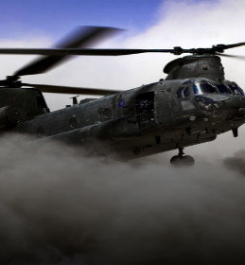
KCMHR health and wellbeing study cohort
Started in 2003 to look at health and well-being of those deployed to Iraq (Operation TELIC) – includes Afghanistan (Op HERRICK)
Tri-service (Army, Royal Navy, Royal Air Force)
Serving and ex-serving, regulars & reserves, men & women
16,000 personal & veterans have participated
Not just deployment
  Mental health
  Family & relationships
  Leaving Service

Slide 5
Perceived impact of military career on children

Slide 6
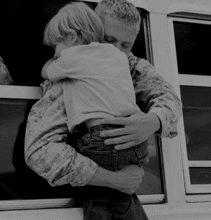
Children of Military Father’s Study (KIDS)
Examine relationship between paternal deployment and PTSD & children’s emotional & behavioural difficulties
Online survey for fathers, mothers, children (aged 11-16 years) & teachers/caregivers
Telephone clinical interview (CAPS, alcohol dependence) for fathers
Main outcome measures:
  SDQ, SCARED, MFQ
621 military fathers, 1044 children
Funded by the US Department of Defense

Slide 7

Best things about having a father in the UK Armed Forces?
“We go to go to good schools because of the discount that dad gets
from the Army.”
Financial benefits (25%)
“That he fights for the country and helps people.”
Sense of pride (25%)
“I have done and seen things most people wouldn’t get to do and it’s been really fun … .”
Relocating (21%)

Slide 8
Worst things about having a father in the UK Armed Forces?
“Him never being around.
He missed most of my childhood.”
Lack of contact (61%)
“No, it has always been part of my life and I am used to it.”
Nothing (18%)
Relocating (16%)
“That we have to leave friends and family behind when we move.”

Slide 9
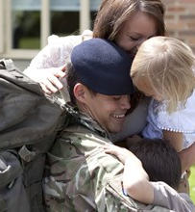
What did we find?
Paternal deployment to Iraq or Afghanistan was not associated with childhood emotional and behavioural difficulties
Paternal probable PTSD status was associated with child (<11 years) hyperactivity
  Limited to boys only
Paternal depression associated with adolescent (11-16 years) anxiety and depression

Slide 10

Service Parents' & Adolescents' Challenges
& Experiences Study
To investigate the mental health of adolescents and communication in military families, in particular the effects of paternal PTSD
Home visits with fathers, mothers and children (aged 11-17 years)
  One-to-one interviews, family functioning and questionnaires
Main outcome measures:
  DAWBA, PHQ-9 and PCL-5
126 families
Funded by the US Department of Defense

Slide 11
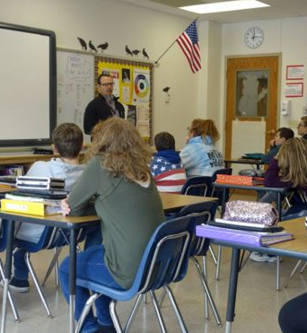
Mental Health and Educational Attainment
Many service children who move frequently are likely to suffer poor behaviour and do not perform well as their peers across all key stages;
Greater number of behavioural, emotional and disciplinary problems which impact educational outcomes;
Parental mental health status has been shown to impact attainment;
Military children are at a greater risk of psychosocial problems compared to their peers.

Slide 12

Gaps in the literature
Role of family functioning
UK military populations
Adolescent age group
Paternal PTSD or depression
Maternal mental health
Data from multiple informants
Diagnostic instruments
Notes:
But these studies are not without their flaws.
Gaps in the literature in general:
Studies have rarely considered the role of family functioning in the association between paternal and adolescent mental health
And they have certainly not done so in UK military populations
Studies have looked at various offspring age groups but have not focused on adolescence, despite this age group being particularly vulnerable to mental health disorders.
With the exception of a few, there has been a tendency to focus on paternal PTSD, despite depression being much more prevalent in military populations
Studies have lacked data from multiple informants
And have typically not used diagnostic instruments to measure child mental health, instead using screening questionnaires, the clinical relevance of which might be in doubt.

Slide 13
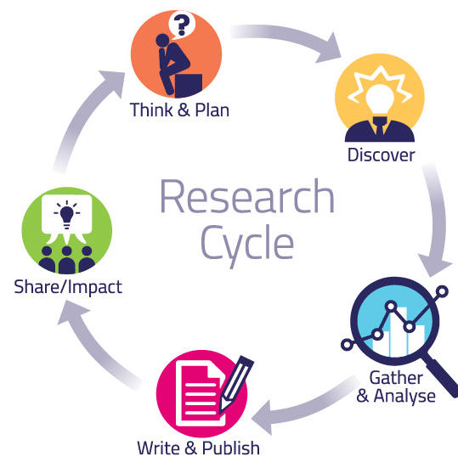
So what are we doing next?
Trajectories of mental health and wellbeing among children/young people from military families – PhD project (2018-2021)
Educational outcomes of children/adolescents from military families linked to NPD and UCAS
SCiP Hub London

Slide 14




























Slide 15





Thank you!
www.kcl.ac.uk/kcmhr
rachael.gribble@kcl.ac.uk
daniel.leightley@kcl.ac.uk
@kcmhr
@rjgribble
@_Dr_Daniel

Slide 16

Questions for you
1. Do our results surprise you or are expected?
2. How do you think these findings relate to your own experiences with the education system and third sector?
3. What do you want us to look at and how can we work together?

