Slide 1

SCiP Alliance Conference
8th October 2018
Moira Leslie Education Manager

Slide 2

Our Vision
“We seek a world where children and young people from Armed Forces communities reach their full potential.”

Slide 3
RCET Family Support
Our Family Support Programme offers:
relevant support, advice and guidance to parents and families
signposting to other support services
targeted and appropriate financial assistance to families in need of support eg school uniform, tuition, residential trips (UK based), after school activities
financial assistance to further and higher education students

Slide 4

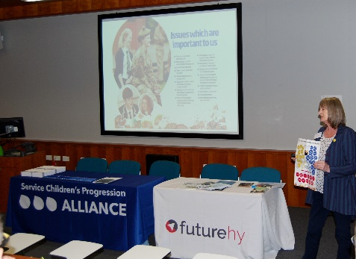
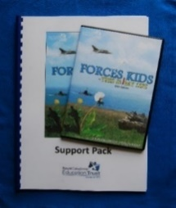
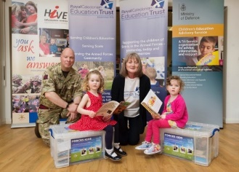
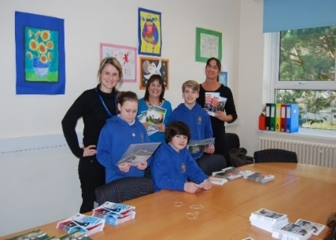

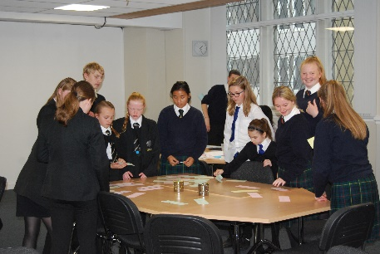
RCET Education Programme
Resources
Training / Presentations
Partnerships/
Community Engagement
Research
Pupil Voices

Slide 5
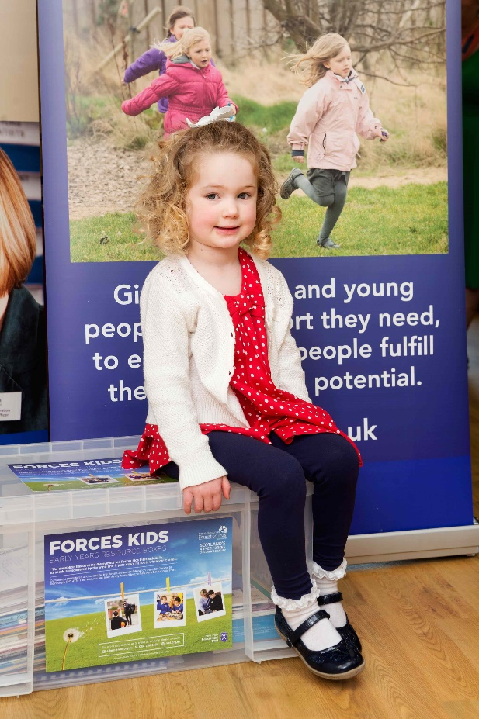
Vulnerable & Unsupported
‘Anecdotal evidence suggests that children affected by a family member in the Armed Forces have felt unsupported by professional and peers and there has previously been very little empirical evidence about this vulnerable group’
Source: State of Children’s Rights report 2016 by Together.

Slide 6
Scottish Government
“We recognise that the children of Service families face additional obstacles in accessing the curriculum due to the nature of their parents’ postings in the Armed Forces.
There is a challenge, then, in ensuring that these children benefit from the same standard of, and access to, education as any other child or young person in their area.”
Source: Our Commitments Scottish Government Support for the Armed Forces Community in Scotland, 2012

Slide 7
This Workshop
RCET Research Projects
Teen Talks Project
The SCiP Alliance Scotland Hub

Slide 8
RCET Research Projects
Dr Sharon Pexton
PhD Student – University of Stirling
On-line Research Poll
Grants recipients

Slide 9


PhD Research Project
Title: Researching the experiences of children and young people from armed forces families
Collaboratively funded doctoral study : ESRC and RCET
Responds to a gap in qualitative in-depth studies (mostly conducted outside uk) on the experiences of young people
Thesis submitted August 2018, examination December 2018

Slide 10
Methodology
Primary and secondary schools in Scotland
School year 2015/16
Fieldwork
Qualitative methods

Slide 11
Research questions
What are the most significant features of children’s descriptions of their experiences of having a parent in the armed forces?
Understanding subjectivity as a form of becoming, how do children describe themselves in relation to being part of an armed forces family?
What do children’s accounts suggest about school-based support for children from forces families?

Slide 12
Findings
Provides empirical evidence about how children account for their experiences of being part of a forces family and seeks to inform school-based response-making

Slide 13
RCET Online Research Poll Findings
23% attended 7 or more schools
70% reported lack of confidence
71% reported anxiety and worrying
60% reported difficulty in studying
44% reported feelings of isolation
49% reported difficulty with friendships

Slide 14
RCET Internal Projects
Grant Recipients
Veterans’ Focus Groups

Slide 15

The Challenge Facing Us Today
Our Grants Recipients are living :
With mental health issues (43%), ill health, disability
As carers
With family breakdown (36%)
With poverty (51%), debt (65%), unemployment
(71%)
With parental substance misuse (8%)
With domestic violence (15%)
With a parent in prison, or with relatives (2%)
Impact:
Obstacles to their education
Long term effect of adverse childhood experiences
Source: 2016 RCET Evaluation questionnaires; Sample 72 children/young people

Slide 16
Veterans’ Focus Groups
Executive summary extract
Research gaps:
Lack of research focussing on needs of children
Mental health provision
Reporting mental illness
Separated spouses
Financial management and poverty

Slide 17


Slide 18


Slide 19

Teen Talks
Gave us the opportunity to discuss important issues
Gave us more confidence to speak out.
93%
83%
Made us more aware of our rights.
Please include civilian families.
95%
63%
We want more events like this.
95%

Slide 20
SCiP Alliance Scotland Hub
Established May 2018
Membership
Two meetings per year
Proposed action points

Slide 21

Moira Leslie
Education Manager
edprogofficer@rcet.org.uk
01381 620412
www.rcet.org.uk
www.facebook.com/RCETrust

