Slide 1
Monitoring and Supporting Service Children in FE
    Martyn Rogers
    Assistant Principal at Canterbury College

Slide 2
The aim of this session
Outline current practice for identifying and supporting service children transitioning to Further and Higher Education
How you can capture, monitor and support the learner
Identify problems that may arise putting this into practice
Share best practice across the sector and develop awareness to improve the scale and quality of practice in colleges across the UK in support of Service children

Slide 3
What were the drivers for SCiP engagement?
So what is so different about identifying, monitoring and supporting Service Children?
Linked to the Armed Forces Covenant 2000 – member since 2014
Vulnerable category within the Support Network

Slide 4
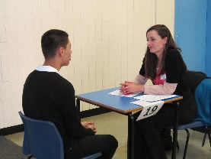
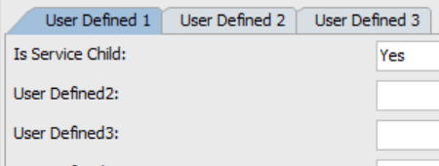
How we record Service Children
Interview and enrolment day captures the data – engage with the learner
Learning Agreement asks the question – Service Child?
Data field linked to SC field within MIS – currently User defined field and not ILR
Link field to additional support fields
Learning difficulty or medical conditions
Prior attainment and Qualifications on Entry
Previous Schools
Care Leaver, Child in Care (CiC)

Slide 5






How we monitor/support Service Children
Vulnerable Student Register (VSR) – report through Mentors and Safeguarding Team
Student Progression Mentor –
1-2-1 Tutorials in 1st Term – information gathering exercise and Destinations captured
Student Services – Bursary, FSM, Learner Support Fund, Care Leavers
MIS Reports – attendance, disciplinary meetings, pastoral support meetings and other such mechanisms through Term
Emotional Wellbeing Centre (EWC) – Pastoral Support and Counselling
Students’ Union – Class Reps

Slide 6

So what can we do collectively?
Networking and raising participation at support conferences – AoC, NAMSS and Regional FE and HE Groups
Data sharing and Destination – GDPR implications
Record and report Retention and Achievement
Introduce the data collection as part of the Enrolment process
Share best practice from a local and national forum
Students’ Union – SC Alumni possibly
Student Mentor involvement and signposting support – already in place but may need raising at College/University level

Slide 7
To Summarise?
You may already be doing this – just needs a tweak
It is about self declaration and pastoral support – sounds simple
Mobility and Young Care Leavers are key areas that affect their education
Strong attributes for employment – organised, disciplined, resilient and more so adaptable
Networking is critical to establish a common practice, especially the transition from Secondary to Further and then onto Higher Education

Slide 8

Thank you for listening but more so for your support to the learners
Any Questions?

