Slide 1
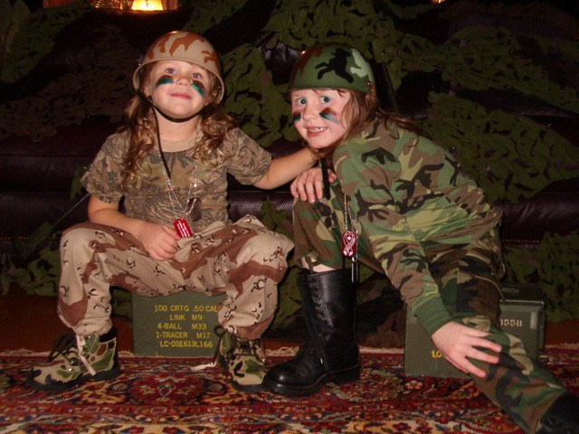

Growing up as a Service child
Matt Blyton, School Improvement Adviser, NYCC & SCISS vice chair
Matt.blyton@northyorks.gov.uk
Notes:
Data from Y6 survey, Y2 results varied by a few % points but trends were similar
The GUNY survey is a large survey of pupils in North Yorkshire
Every school can take part
It happens
every 2 years
Being healthy
Being happy
Learning

Slide 2

‘Kin and Country’ (June 2018)
‘The vast majority of service children we spoke to during this project were happy, resilient and incredibly proud to have a parent serving in the Armed Forces…it is clear that the children in our military families should be celebrated.’
Notes:
From Anne Longfield’s introduction and to acknowledge that we must bear in mind that not all Service pupils present with issues.

Slide 3
‘What is clear from our research is the unique nature of childhood in a serving military family. The all encompassing character of a military lifestyle means service children can experience growing-up’ quite differently from their peers.’
Anne Longfield
Notes:
Explain what my short presentation aims to do:
Explain some of this uniqueness
Share some findings from work in NYCC which reveals the POTENTIAL negative impact and the need for education professionals to UNDERSTAND and provide relevant SUPPORT.
Key recommendation: The majority of service children we spoke to were happy, resilient and proud that their parents were serving in the Armed Forces. However, it is clear that a number of changes should be made to help children
growing up in service families with the unique challenges they face.
LINK TO BETH AND PAIGE – 2012 Service Pupils’ Voice conference – set contaxt

Slide 4
Service pupil voice: Beth and Paige (14)
Service pupils don’t want to be treated completely differently, but they want to be understood. This extends to being understood by their civilian peers as well as by school staff.
In response to the question Should schools treat Service Pupils any differently to other pupils? the overwhelming majority said ‘Yes, but just a little bit!’

Slide 5
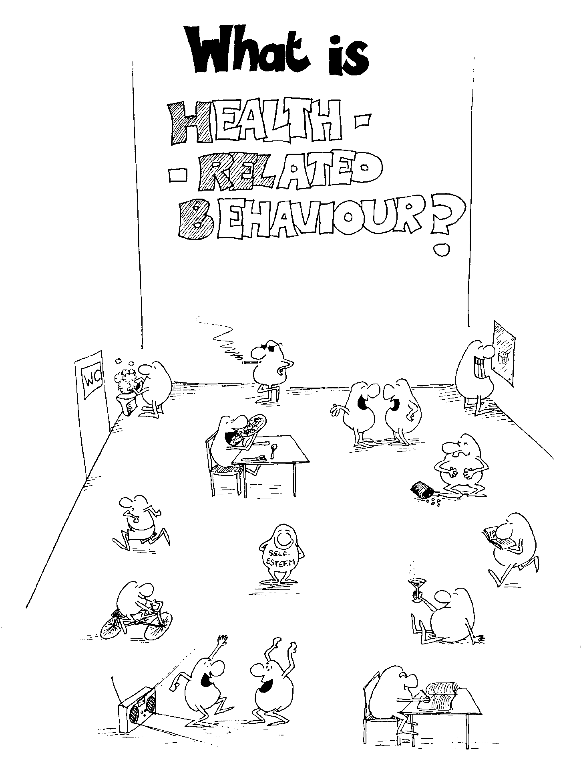

Growing Up in North Yorkshire: 2016 results
Being healthy
Being happy
Learning
Notes:
Overview of survey and how its used.
North Yorkshire County Council wants every school to have a picture of their pupils’ health and wellbeing

Slide 6
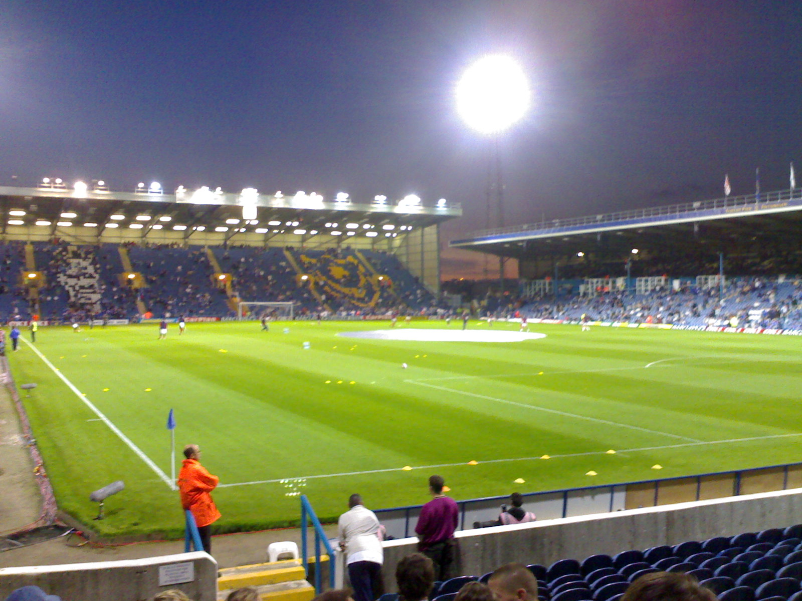
2016 - Over 20,000 children
Over 300 schools
(83% of North Yorkshire)
Notes:
Fratton Park, Portsmouth

Slide 7
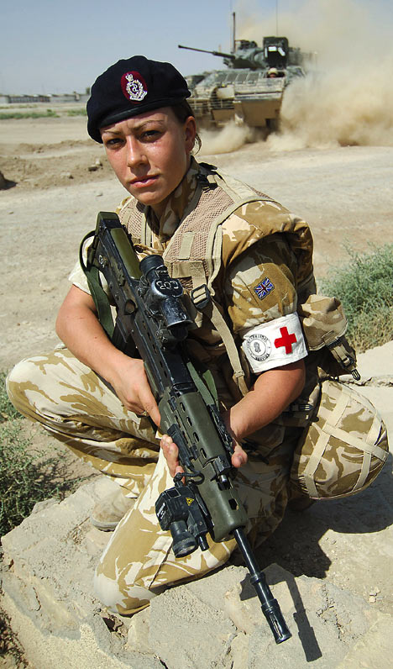
Year 6
Year 8 & 10
Notes:
Brief overview of numbers of known SPs in the county and the 12 bases

Slide 8
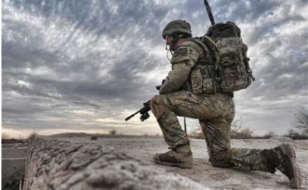
5% of
all NYCC

Slide 9
Getting better – Forces children (statistically sig):
NORTH YORKSHIRE
 | 2014 | 2016
% who at least ‘sometimes’ play ball games during school outdoor break-times (Y6) | 68 | 83
% who can ‘usually or always’ say no when a friend wants them to do something they don’t want to (Y6) | 47 | 64
% responded that they ‘quite’ or ‘very’ often worried about SATs (Y6) | 39 | 26
% who said they have experienced negative behaviour outside of school during break-times over the past month (Y8+10) | 33 | 19
% who say that they have found school lessons about smoking education ‘quite’ or ‘very’ useful (Y8+10) | 43 | 55
% who say that they have found school lessons about alcohol education ‘quite’ or ‘very’ useful (Y8+10) | 44 | 55
Notes:
How we use the results to not only consider priorities for improvement and projects, but also measure impact of what we have done
Awaiting the 2018 report which I am happy to share.

Slide 10

Year 6
15%
?%
Changed schools 2+ times
Notes:
Let’s play ‘higher of lower’ – some pairs discussion. 7 results for primary; 7 for secondary.
NB All examples are statistically significant differences to the NY figures – FOR THE STATISTICIANS IN THE ROOM:
where p = <0.01 (1%) or <0.001 (0.1%)

Slide 11
Year 6
15%
51%
Changed schools 2+ times

Slide 12
Year 6
67%
?%
Family has 2+ cars

Slide 13
Year 6
67%
52%
Family has 2+ cars

Slide 14
Year 6
79%
?%
Always feel safe at school

Slide 15
Year 6
79%
69%
Always feel safe at school

Slide 16
Year 6
80%
?%
School deals with bullying

Slide 17
Year 6
80%
70%
School deals with bullying

Slide 18
Year 6
4%
?%
Young carer

Slide 19
Year 6
4%
9%
Young carer
Notes:
MB the figure for secondary was 10%

Slide 20
Year 6
17%
?%
Low resilience measure

Slide 21
Year 6
17%
25%
Low resilience measure

Slide 22
Year 6
55%
?%
Active 5+ hours per week

Slide 23
Year 6
55%
46%
Active 5+ hours per week

Slide 24
Year 8 & 10
43%
?%
Changed schools 2+ times

Slide 25
Year 8 & 10
43%
74%
Changed schools 2+ times

Slide 26
Year 8 & 10
27%
?%
Have tried electronic cigarettes

Slide 27
Year 8 & 10
27%
39%
Have tried electronic cigarettes

Slide 28
Year 8 & 10
44%
?%
Want a job after school years

Slide 29
Year 8 & 10
44%
55%
Want a job after school years

Slide 30
Year 8 & 10
24%
?%
Unusual amount of exercise
to lose weight

Slide 31
Year 8 & 10
24%
33%
Unusual amount of exercise
to lose weight

Slide 32
Year 8 & 10
8%
?%
Carry weapons at least sometimes

Slide 33
Year 8 & 10
8%
13%
Carry weapons at least sometimes

Slide 34
Year 8 & 10
19%
?%
Have been offered cannabis

Slide 35
Year 8 & 10
19%
25%
Have been offered cannabis

Slide 36
Year 8 & 10
47%
?%
Talk to someone if stressed

Slide 37
Year 8 & 10
47%
39%
Talk to someone if stressed

Slide 38
Top assets
and concerns
(primary)

Slide 39
PRIMARY Y6
Notes:
Print as handouts

Slide 40
PRIMARY Y6
Notes:
Print as handouts

Slide 41
Top assets
and concerns
(secondary)

Slide 42
SECONDARY Y10
Notes:
Refer to handouts

Slide 43
SECONDARY Y10

Slide 44

CORE PURPOSE:
‘To champion the education and wellbeing of Service children so that they achieve the best possible outcomes, by engaging with policy-makers and developing / sharing effective practice.’
https://www.scipalliance.org/about/partners/service-children-in-state-schools
Notes:
Please come and introduce yourselves during the day and find out more about the work and achievements of SCISS (film)

