Slide 1
Access to higher education for students from military service families
David Barrett
Assistant Director, Fair Access and Participation
September 2018

Slide 2
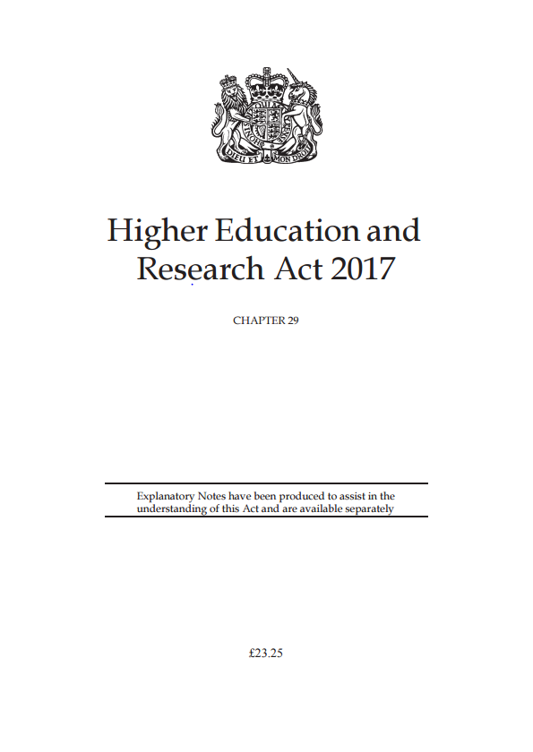
OfS general duties in HERA 2017
(a) protect the institutional autonomy of English HE providers
(b) promote quality, and greater choice and opportunities for students, in the provision of HE
(c) encourage competition between English HE providers in connection with the provision of HE where that competition is in the interests of students and employers, while also having regard to the benefits for students and employers resulting from collaboration between such providers
(d) promote value for money in the provision of HE
(e) promote equality of opportunity in connection with access to and participation in HE
(f) use the OfS’s resources in an efficient, effective and economic way
(g) regulatory activities should be—
(i) transparent, accountable, proportionate and consistent, and
(ii) targeted only at cases in which action is needed.
Notes:
Key points:
The UK has a thriving, world renowned HE sector.
To ensure the HE sector thrives, the OfS must consider:
Institutional autonomy
Promote choice and competition for students
Promote value for money
Be a transparent and proportionate regulator
Promote equality of opportunity
The OfS has a statutory duty to ensure higher education providers promote equality of opportunity.
Promoting equality of opportunity will greater strengthen our higher education system (see next slide)

Slide 3
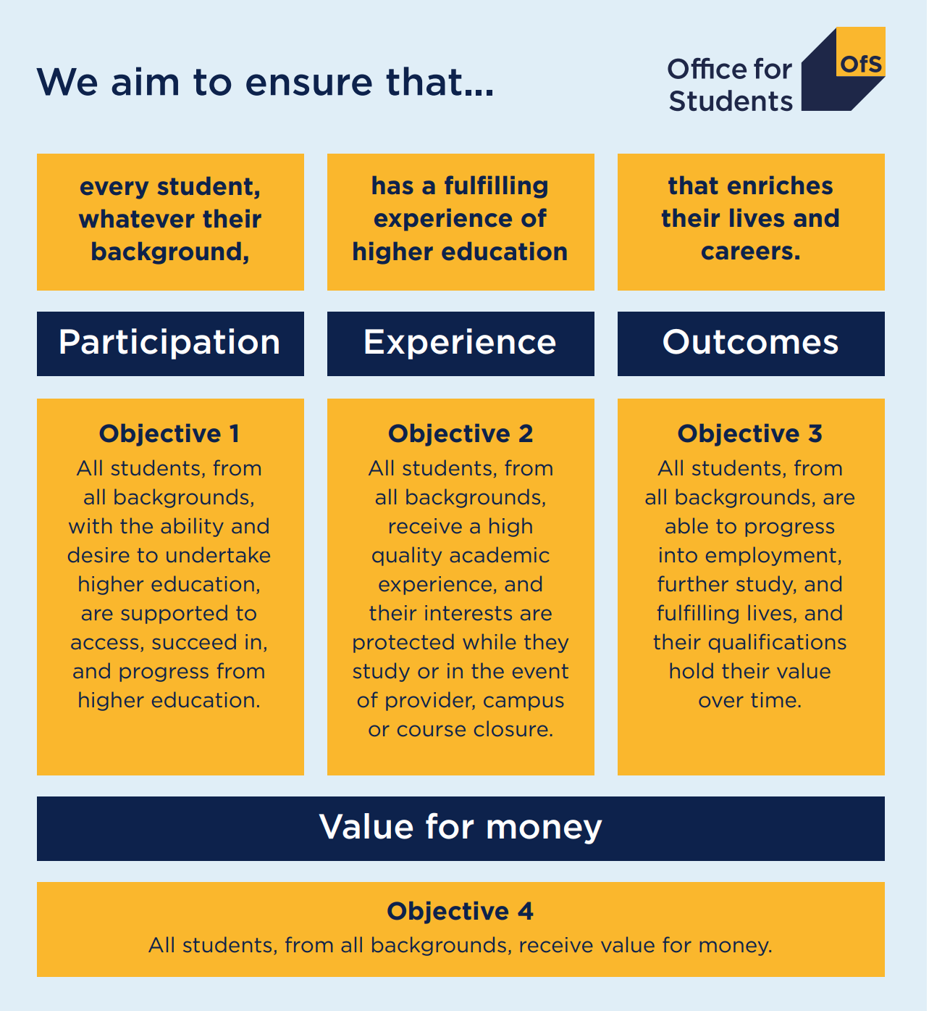
Notes:
Key points:
The OfS is the new independent higher education regulator
Our aim is that “every student, whatever their background, has a fulfilling experience of higher education, that enriches their lives and careers.
Four key objectives
First objective is relating to participation: all students, from all backgrounds, with the ability and desire to undertake higher education, are supported to access, succeed in, and progress from higher education.
Access and participation is important to the OfS and will permeate throughout our work. A focus on students.
Our work covers all students whether undergraduate or postgraduate, national or international, young or mature, full-time or part-time, studying on a campus or by distance learning.

Slide 4

The benefits of equality of opportunity in higher education
Diversity of thinking in the learning environment
Promote a strong economy: skills and the industrial strategy
Social and moral responsibility
Improving social integration

Slide 5

The challenge set by the OfS Board
‘Our regulatory framework enables the Director for Fair Access and Participation to develop a bold new approach to supporting social mobility, and equality and diversity, through higher education. …We will be radical and ambitious to make sure we deliver on the promise of higher education as an engine for social mobility, and a gateway to a better life for those who undertake it.’
Notes:
Key point:
The OfS is committed to transformational change in access and participation
We have been challenged by the OfS board to take a ‘bold new approach’ and be ‘radical and ambitious’

Slide 6
Objective 1: Access, success and progression
All students, from all backgrounds, with the ability and desire to undertake higher education, are supported to access, succeed in, and progress from higher education.
Identify measures of access, success and progression
Identify groups with different experiences
Measure gaps between different groups
population referenced entry rates and participation rates,
non-continuation rates,
completion rates,
chances of getting a first / upper second,
chances of highly skilled work or further study
Underrepresented groups
Protected equality and diversity characteristics
Measures based on higher education participation (POLAR, GAPS),
Intersectionality, multiple measures (MEM)
Differences in rates
Relative chance
Difference from expected
And then is the gap reducing through time
Notes:
Slide provided by Maggie.
Can link with targets/KPM’s/national priority areas in the consultation.
Note that you may want to include stories about individual students as well as using data to highlight the issues.

Slide 7
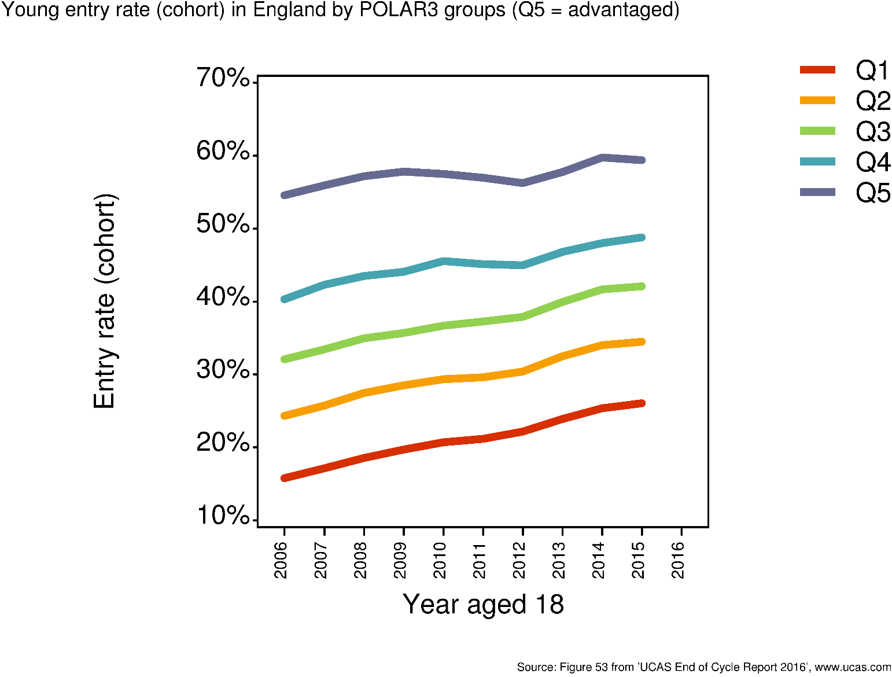
Where you live - POLAR
Access
There is a 33 percentage point gap between the proportion of young people from the highest participation areas entering higher education by age 19 compared to those from the lowest participation areas.
59%
26%
Source: UCAS End of Cycle Report 2016
Notes:
Key points:
More young people from low participation areas going to higher education than ever before
However, the gaps in participation have not closed. 33 percentage point difference between Q1 & 5

Slide 8
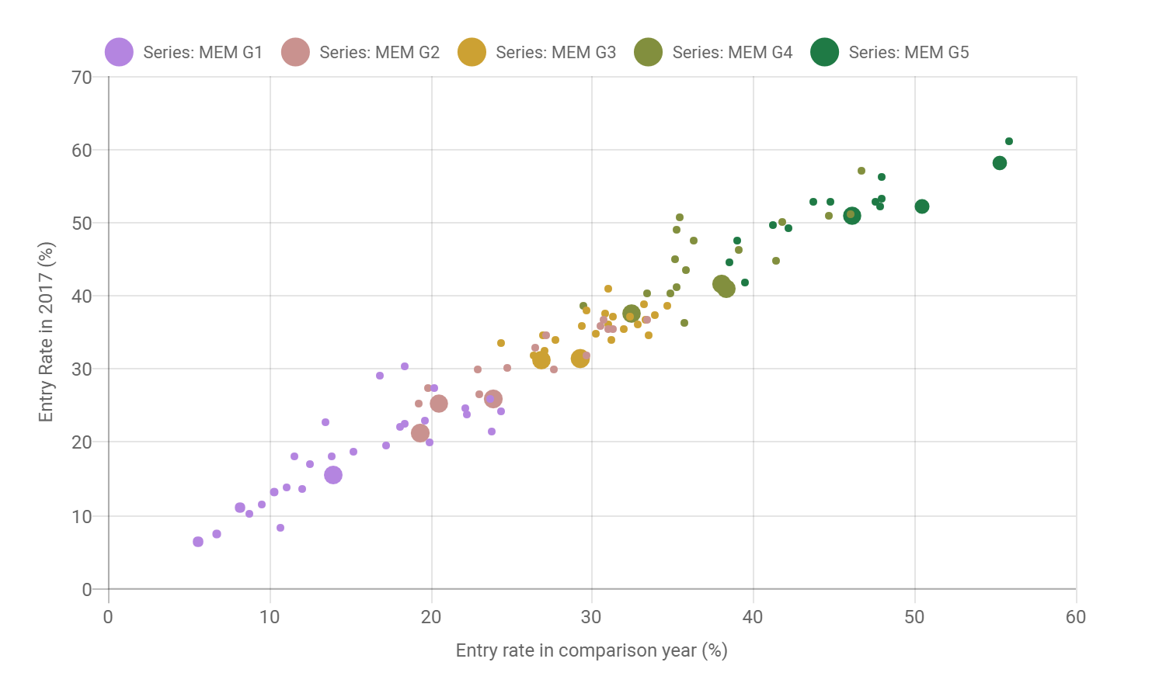
Multiple dimensions to equality
Super-disadvantage

Slide 9
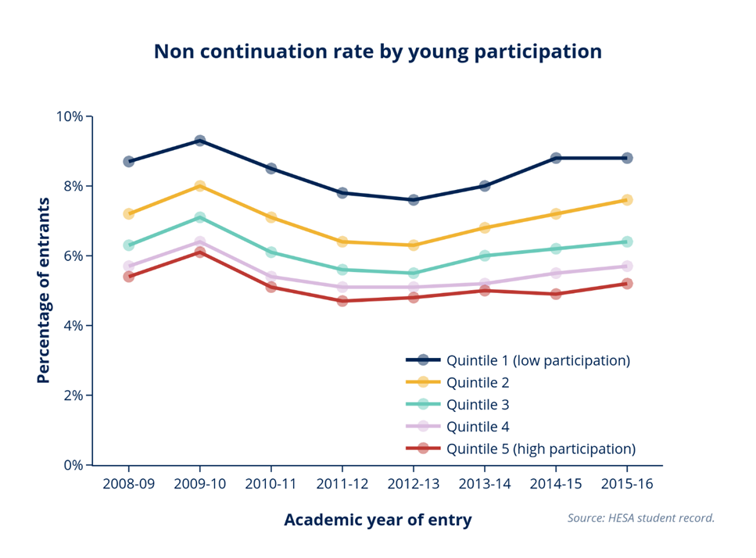
Where you live - POLAR
Success: non-continuation
The gaps in access grow when continuation into second year is measured.
For those entering higher education in 2015-16 the non-continuation rate of young entrants from the lowest participation areas is 3.6 percentage points higher than the non-continuation rates of those from the highest participation areas
https://www.officeforstudents.org.uk/data-and-analysis/non-continuation-rates-and-transfers/
Notes:
Key points:
Those from low participation areas are more 3.6 percentage points likely to drop out of higher education.
The gaps have remained.

Slide 10

A new approach to regulating access and participation in English higher education
Outcomes focused
Evidence based
Greater pressure and support from the regulator
Self-assessment of performance across the lifecycle
Actions to address identified gaps
Rigorous use of evidence and evaluation
High ambition

Slide 11
The future of access and participation
Transformation – step change
We are aiming to achieve significant reductions in the gaps in access, success and progression over the next five years
Notes:
Key points:
1. We are aiming to achieve significant reductions in the gaps in access, success and progression over the next five years
2. And ensure our access and participation regulation and funding are outcome-based, risk-based, underpinned by evidence and joined up with other OfS regulatory activities.
3. The review:
Focus on all stages of the lifecycle
Highlight our expectations for ambition
Highlight the importance of being outcomes focused
Highlight the role of evaluation/evidence
4. Ultimate aim of ensuring all students, from all backgrounds, with the ability and desire to undertake higher education, are supported to access, succeed in, and progress from higher education.

Slide 12
Access to HE for young people from military service families
OfS duty to promote equality of opportunity in connection with access to and participation in HE
Armed forces Covenant – those who serve, or have served, and their families should face no disadvantage compared to other citizens in the provision of public and commercial services
Access is low compared to the general population
      24 per cent compared to 43 per cent
  The gap is large
      Around 19 percentage points
    75,000 service children in secondary and primary school in receipt of Service Pupil Premium (SPP)

Slide 13
Educational journey of service children
Good starting point
Positive qualities associated with military service families
      open-mindedness, pride, determination, resilience
High aspiration to go to HE (78 per cent of parents would like their children to go into HE)
Overall service children appear to attain well up to GCSE attainment compared to general population

Slide 14
Educational journey of service children
…but there are challenges that affect access to HE
Large gaps in prior attainment between commissioned officers and lower ranks (where attainment is lower than the general population)
Mobility and family separation can impact on educational and emotional wellbeing
Moving between schools can impact on academic outcomes
      Inadequate transition arrangements
      Access to extra-curricula activities
      Access to further education provision
      Access to student finance

Slide 15
Young carers in military families
Caring for siblings or parents
Children's society research young carers in military families less likely to receive support than young carers in civilian families
      Mobility affects continuity of support
Young carers often struggle in HE because of their caring responsibilities Carers trust and Nottingham research
      higher incidents of poor mental and general health
      lower GCSE attainment
      greater likelihood of not being in education, employment or training aged 16-19

Slide 16


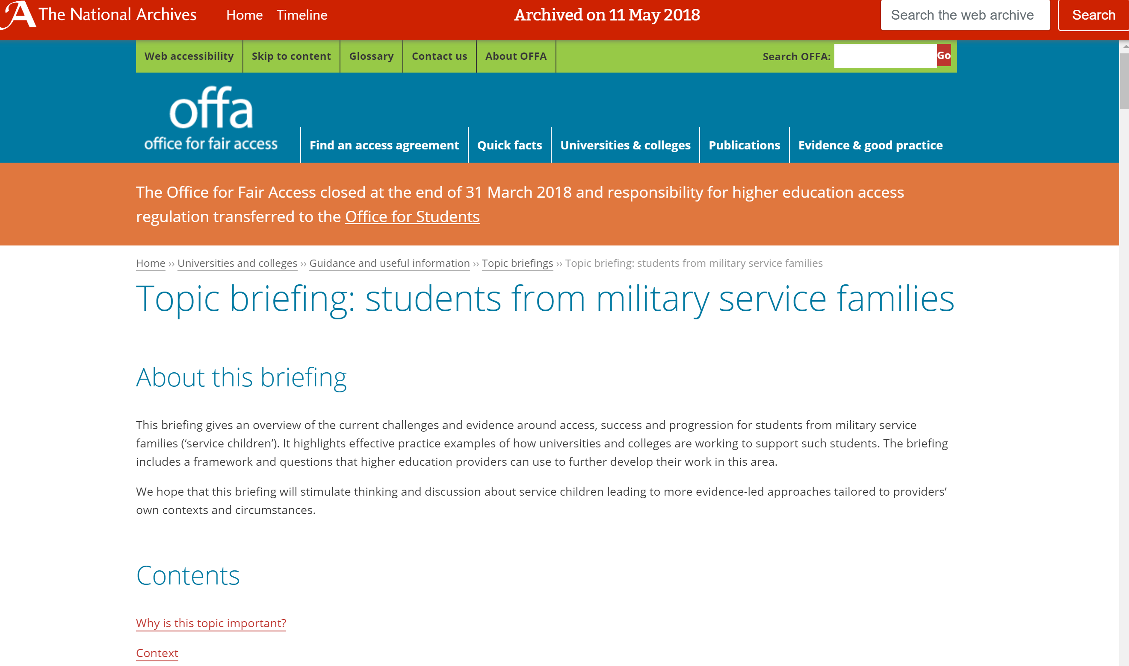
What action are we taking?
OfS regulation and guidance

Slide 17
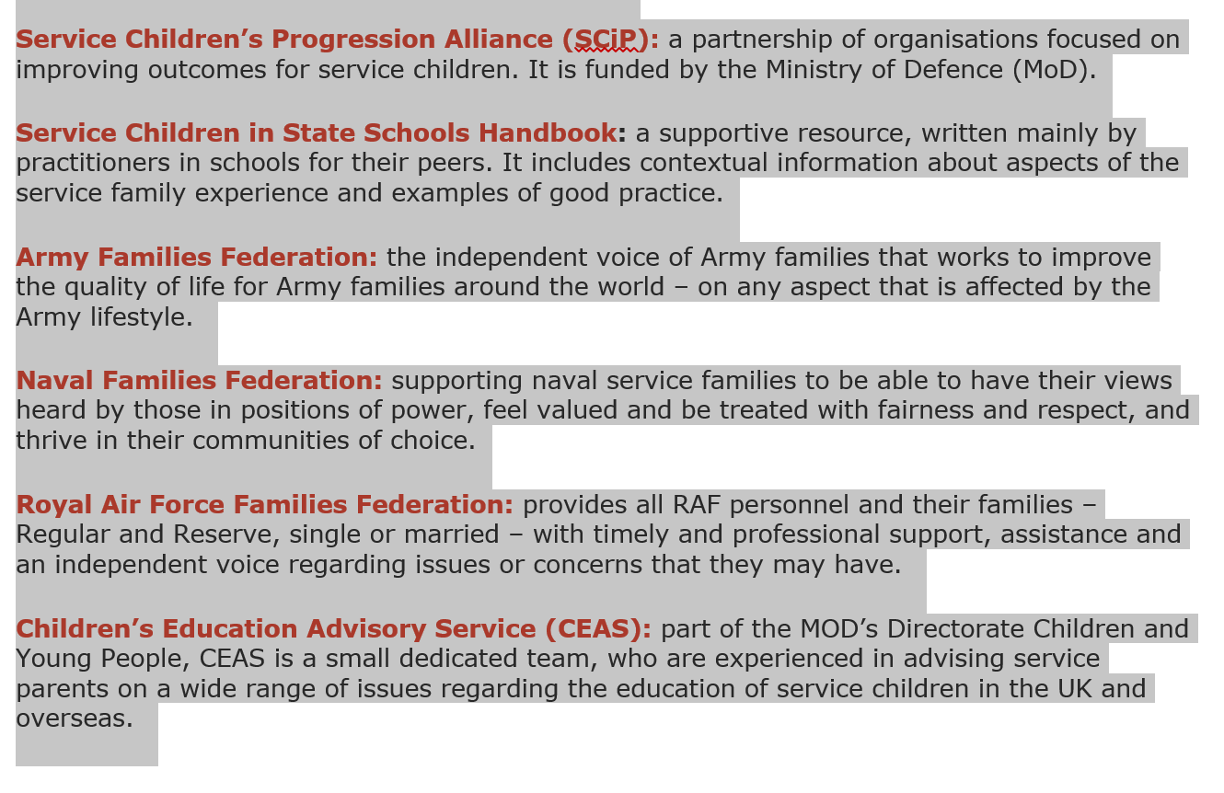
Resources

Slide 18
HE providers referencing military service children in their access agreements – but many more have committed to take action in the covenant
2018-19 (7)
Bath Spa University, Grimsby Institute of Further and Higher Education,
London South Bank University, University of Central Lancashire, University of Southampton, University of Suffolk, University of Winchester
2017-18 (5)
Bath Spa University, Harper Adams University, University of Southampton,
University Campus Suffolk, University of Winchester
2016-17 (5)
Bath Spa University, Falmouth University, University Campus Suffolk Ltd, University of East Anglia, University of Winchester
48 HE providers and 29 FE providers have become Armed Forces Covenant Signatories (others may have done so in collaboration)

Slide 19
What are HE providers doing?
Actively working with schools and local authorities
Include in targeting criteria for outreach (schools, community and adult)
Make them a priority group
Partnership between SCiP Alliance members – share good practice and collaborative outreach
Understand the challenges of mobility (allowing flexible application timetables for schools part-way through year)
Bespoke outreach for service children
Work with MoD

Slide 20
What can providers do?
Understand
Providers could usefully understand their own contexts with regards to service children by:
analysing student cohort data to gauge the size of their military service student population. This could include examining their distribution across programmes and to what extent this population intersects with other under-represented groups (e.g. young carers). This may require reaching out to existing student populations to identify those students whose parents were formerly members of the armed forces.
analysing data on local school and college populations to identify opportunities for outreach activities
encouraging and supporting research into and evaluation of the educational experiences of service children.

Slide 21
What can providers do?
Access
Providers could usefully address questions of access by:
engaging members of staff with connections to the military, as well as existing students from military families, to assist in developing and delivering outreach activities
forming partnerships with local authorities and local schools
considering service children when allocating places on higher-intensity outreach activities
developing recruitment-focused resources that specifically recognise students from military service families
recognising the impact of disruptions to education due to family mobility, both in terms of academia and extra-curricular activities, and taking this into account when assessing applications
arranging CPD support for teachers in understanding progression routes to higher education and the support services available.

Slide 22
What can providers do?
Success
Providers can support the success of service children by:
ensuring that student support services and academic staff are aware of the challenges that might be experienced by service children, particularly where these are connected with mental health or caring responsibilities
having a designated point of contact within student support services
engaging the Student Union and others in developing student support networks for those from military service families.

Slide 23
What can providers do?
Continuous development
Providers can continue to develop their support for service children by:
engaging with networks such as the Service Children’s Progression Alliance (SCiP), Service Children in State Schools, local civilian military partnerships, the Army Families Federation, the Naval Families Federation and the RAF Families Federation
demonstrating their commitment to widening opportunity for the families of service personnel by making specific commitments through the Armed Forces Covenant
participating in the research community around military service families.

Slide 24
Thank you for listening
David Barrett
Assistant Director, Fair Access and Participation
September 2018

