Slide 1
From evidence to action: meeting the needs of children from service families
Claire Brown, Her Majesty’s Inspector
Specialist Adviser for Inspection Policy and Quality
8 October 2018
Notes:
Aims

Slide 2
My focus today
With our current inspection framework in mind, what might leaders wish to consider in relation to children from service families?
What does Ofsted expect from schools during inspection?
How is Ofsted developing the new education inspection framework which will be implemented in September 2019?

Slide 3
‘What is clear from our research is the unique nature of childhood in a serving military family. The all encompassing character of a military lifestyle means service children can experience ‘growing-up’ quite differently from their peers. The mobile lifestyle of many military families can be tough, with children telling us that multiple school moves leave them feeling unsettled and anxious about achieving good grades. For children with additional needs, moving around can add another layer of complexity, with the
need to find suitable schooling and the transfer of support plans often a complicated and frustrating task.’
Kin and Country: growing up as an Armed Forces child
Anne Longfield, OBE, Children’s Commissioner, June 2018

Slide 5
Inspectors will consider:
the design, implementation and evaluation of the curriculum, ensuring breadth and balance and its impact on pupils’ outcomes and their personal, development, behaviour and welfare
how effectively leaders monitor the progress of pupils to ensure that none falls behind and underachieves, and how effectively governors hold them to account for this.

Slide 6
What did our curriculum survey find?
Lack of curriculum knowledge and expertise
Curriculum being confused with assessment and qualifications
Teaching to the test
Curriculum narrowing Social justice issues

Slide 7

The importance of the curriculum
“Twelve years of education should give children a lot more than a disposition to learn and some ill-defined skills. Yet the evidence from the first stage of our research this year is that the focus on substance, on the knowledge that we want young people to acquire, is often lost…
…If their entire school experience has been designed to push them through mark-scheme hoops, rather than developing a deep body of knowledge, they will struggle in later study.”

Slide 8
Ofsted’s working definition:
‘The curriculum is a framework for setting out the aims of a programme of education, including the knowledge and understanding to be gained at each stage (intent);
for translating that framework over time into a structure and narrative, within an institutional context (implementation), and
for evaluating what knowledge and skills pupils have gained against expectations (impact/achievement).’

Slide 9
Key questions for leaders:
What is our intent?
What are our ambitions for pupils? What is our vision? What are our core values? Have we designed a curriculum that achieves these ambitions?
How effective is our implementation?
How well are we putting our vision into practice? Does our teaching and use of assessment support our curricular intent and reflect our ambition for all pupils?
What is our impact?
Are we being successful? How do we know? Is our curriculum achieving what we set out to do?

Slide 10

What do you mean when you talk about progress?
What does it mean to ‘get better’ at languages, mathematics, history or English?

Slide 11



Knowledge does not sit as isolated ‘information’ in pupils’ minds.

Slide 12





Has the content of the curriculum been learned long term? How do you know?
‘Learning is defined as an alteration in long-term memory. If nothing has altered in long-term memory nothing has been learned.’
Sweller, J., Ayres, P., & Kalyuga, S. (2011). Cognitive load theory (Vol. 1). Springer Science & Business Media.

Slide 13
‘In order to support the pastoral needs of service children, schools have flexibility over how they use the SPP, as they are best placed to understand and respond to the specific needs of those pupils for whom the funding has been allocated.’
‘…to help mitigate the negative impact on service children of family mobility or parental deployment.’
The Service Pupil Premium: what you need to know
DfE, July 2018

Slide 14
Do what is right for your pupils, NOT what you think is right for Ofsted.

Slide 15
Busting the myths:
We don’t expect lesson plans highlighting particular groups of pupils, such as children from service families.
We don’t expect your self-evaluation, including any evaluation of your work with children from service families, in any particular format.
We don’t expect pupil performance or tracking information in any particular format.
We don’t expect curriculum information to be presented in a particular way.
We don’t expect information about your Service Pupil Premium spending in any particular format.

Slide 16
There is no ‘one way’…

Slide 17
What SHOULD you do?
Make the lead inspector aware of the cohort of children from service families in your school.
Don’t be afraid to ask the lead inspector for an opportunity to share the work you have been doing to support children from service families and to highlight the impact.
Be ready to share, succinctly, evidence which explains what you have done, why you have done it and what difference it has made.

Slide 18
Key questions for leaders in relation to children from service families:
What is our intent?
What are our ambitions for pupils? What is our vision? What are our core values? Have we designed a curriculum that achieves these ambitions?
How effective is our implementation?
How well are we putting our vision into practice? Does our teaching and use of assessment support our curricular intent and reflect our ambition for all pupils?
What is our impact?
Are we being successful? How do we know? Is our curriculum achieving what we set out to do?

Slide 19
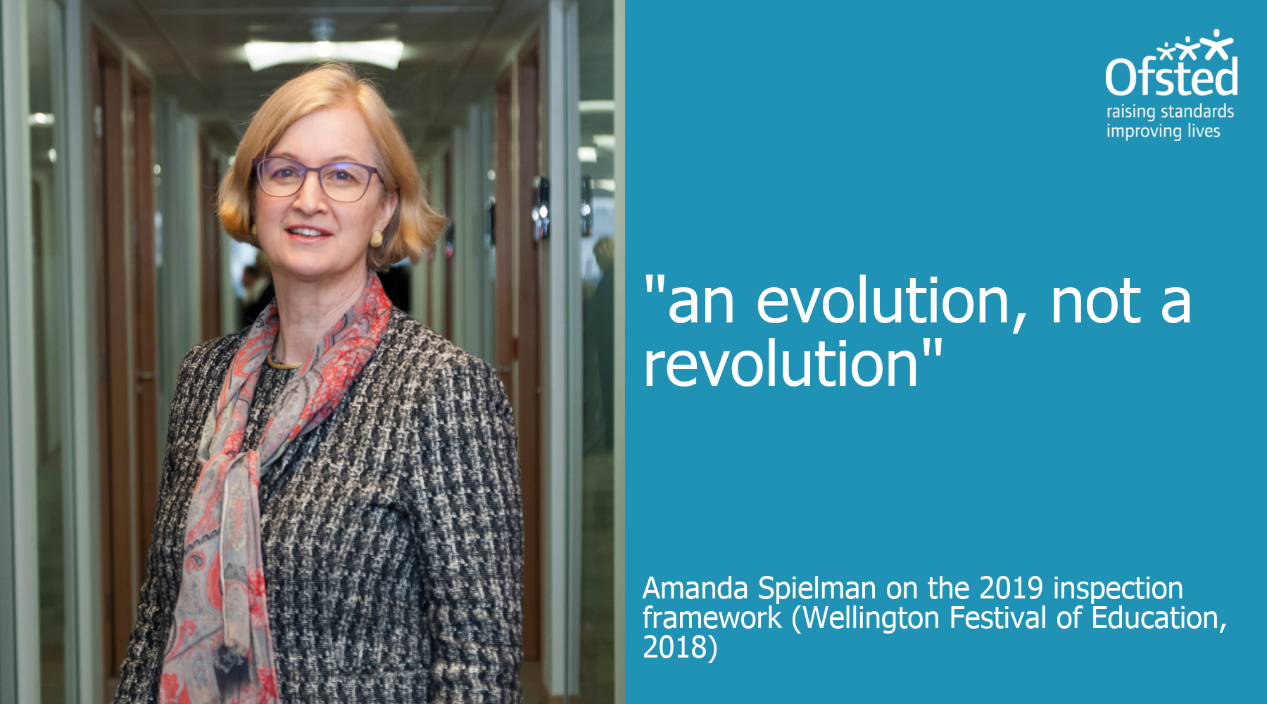

Slide 20
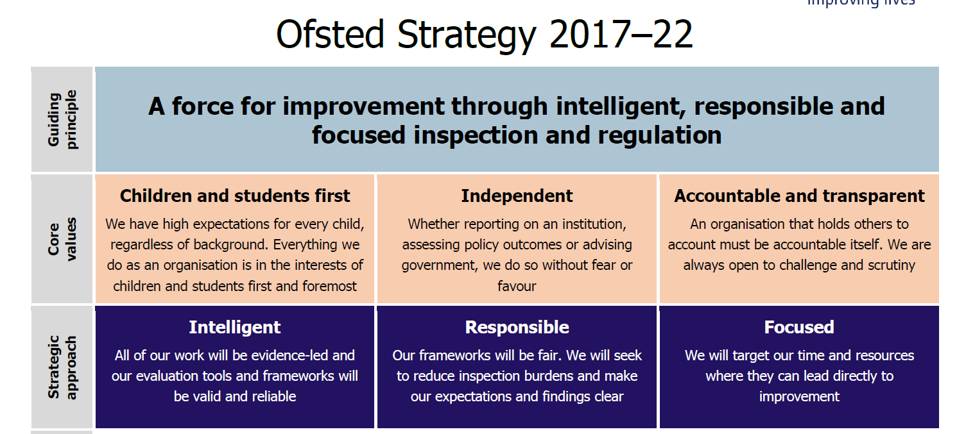
The new framework will be one of the main ways in which we implement Ofsted’s strategy
The new framework will be based on a solid evidence base relating to educational effectiveness and valid inspection practice.
We will continue to be clear about our expectations and fight misconceptions.
We will remove any measures that do not genuinely assess quality of education and training. We will prioritise weaker provision and observe more outstanding practice.

Slide 21
Developing the Education Inspection Framework 2019: our approach
What and why do we inspect?
Purpose
Unit of inspection
What do we look at?
Educational effectiveness
Judgement areas
How do we inspect?
Evidence gathering activities
Inspection event design
What and how do we report?
Grading scale
Sampling and aggregation
Report content
Report design
& format

Slide 22
Towards a 2019 inspection framework – what aspects will we need to judge?
We are clear that we need to take a rounded view of the quality of education offered by schools and providers.
The curriculum will be at the core, recognising the close connection between curricular content and the way that this content is taught and assessed in order to support children to build their knowledge and to apply that knowledge.
We remain very interested in children and learners’ wider development including the attitudes and behaviours they bring to the classroom.
Schools’ and providers’ leadership and management are likely to remain key areas of consideration.

Slide 23
Keep our focus on safeguarding, reflecting Ofsted’s latest thinking
Our inspection of safeguarding will continue to be built around three core areas:
  Identify: are leaders and other staff identifying the right children and how do they do that?
  Help: what timely action do staff within the provider take, and how well do they work with other agencies?
  Manage: how do responsible bodies and staff manage their statutory responsibilities, and in particular, how do they respond to allegations about staff and other adults?
Safeguarding will hold the same weight across all remits.

Slide 24

We will focus more on education; less on internal data
“In the new framework, we’re thinking about how we can take the inspection conversation even further on education itself and less on data.
“We want to know how schools are achieving a good education, not just what the results are.”
HMCI, Education Policy Institute conference, 3 July 2018

Slide 25
Keep the outstanding grade… probably(!)
‘When it comes to the outstanding grade, a number of school leaders and others from the sector have persuasively lobbied me and others to keep it. Their argument is that by losing outstanding we’d send the wrong message about aspiration and excellence in the system.’
‘However, if we are to keep the grading system, I have to be sure the public can have confidence in those grades. That is why I would like to see the removal of the outstanding exemption.’
HMCI, Wellington Festival of Education, 20 June 2018

Slide 26
In summary: key principles as we develop new judgement areas and criteria
Criteria will be based on the evidence relating to educational effectiveness
Continue to make a single, overall judgement about a provider
Continue to emphasise safeguarding appropriately
Reduce focus on data – more focus on how schools are achieving results; less pressure to produce assessment information
Retain the current four-point grading scale
Wherever possible reduce workload: teachers, leaders and inspectors.

Slide 27
What next?
We are undertaking a process of reflection, development and piloting within Ofsted as we look towards the new Education Inspection Framework 2019.
This term, we are beginning to share the developing thinking with partners across the sectors we inspect and invite their thoughts and views – this shapes and influences what we produce.
Research continues on the curriculum, lesson observation, work scrutiny and a wide range of other topics. The findings will feed into the draft framework.
We will consult on the substance and detail of the new framework (not just high level principles) over Spring Term 2019.
The final framework will be published in Summer 2019, and will go live from 1 September 2019.

Slide 29




Ofsted on the web and on social media
www.gov.uk/ofsted
https://reports.ofsted.gov.uk
  www.linkedin.com/company/ofsted
  www.youtube.com/ofstednews
  www.slideshare.net/ofstednews
  www.twitter.com/ofstednews

