Slide 1
What the data tells us
Further Education Provision
for Service Children
Alison Osborne
Northern Hub for Veterans and Military Families Research
Northumbria University

Slide 2

Introduction
Service Life Options
  Family stays in one place, serving member moves
  Whole family moves, service child changes school each time
  Service child attends boarding school, family moves around
Mobility
  Lack of stability and continuity (NAO, 2013)
  Educational stability (AFF, 2016)
Educational Attainment
  Mobile vs. non-mobile (DfE, 2014; HoCDC, 2013)
  Indicator of risk for low achievement (Gibbons and Telhaj, 2013)
  Non-mobile service children > mobile service children > mobile non-service children (DfE, 2010)
Available Support?
Imagery from https://www.cafcass.gov.uk/
Notes:
There are 3 potential service life options that service children may experience:
The serving family staying in one place ensuring educational stability for the service children and the serving member of the family remains mobile
The whole family is mobile and the service child changes school with each move
Service child attends boarding school for educational stability and the family remains mobile
Each option provides advantages and potential concerns. The mobility of children between schools has been identified as a particular concern, both for service children and for their non-service peers. Specifically a lack of stability and continuity was identified by service parents (NAO, 2013). There are a number of military families that choose stability, with many citing educational stability for their children as the main reason (AFF, 2016).
The Department for Education (2014) indicated that, as a group, service children do not underachieve. However, mobile service children are thought to perform less well than non-mobile service children (HoCDC, 2013). Gibbons and Telhaj (2007) argue that mobility is not a major cause of low achievement among pupils generally, but that mobility may be a useful indicator of pupils who are at risk for low achievement. DfE (2010) found that service children perform better than their non-service peers, after controlling for prior attainment, demographic factors and mobility, The same report found mobile service children performed less well than their non mobile service peers, but that mobile service children performed better than mobile non-service children.
Research suggests that being a service child can have an impact on education, so what support is available?

Slide 3

Current Policies/Funding
Armed Forces Covenant
  “should face no disadvantage compared to other citizens ” (MOD, 2016)
Government
  Service Pupil Premium (England)
  Pupil Information Profile (UK) / Common Transfer File (UK)
MOD
  Continuity of Education Allowance (UK)
  Special Educational Needs Addition (UK)
  Day School Allowance (North Wales)
What Happens Post-16?
Imagery from https://www.protocolgroup.org.uk/apprenticeship-funding-will-work/
Notes:
Efforts have been made to improve support for service families. The Armed Forces Covenant was introduced to ensure that members of the Armed Forces Community should face no disadvantage compared to other citizens in the provision of public and commercial services.
Initiatives specifically aimed at supporting service children have also been implemented through the Government and MOD. Service Pupil Premium provides funding for schools where parents have declared their Armed Forces status. To be eligible for this, pupils must have a parent serving in the Regular Armed Forces (this includes those on full commitment Full-Time Reserve Service), have been registered as a service child in the school census since 2011 or have a parent who died in service. The Service Pupil Premium provides schools with £300 per year, per service child to provide additional support service children may need – primarily of pastoral nature.
The Pupil Information Profile was introduced in 2014 to ensure a comprehensive transfer of information between schools for mobile service children. This is recommended and referred to in the SEND Code of Practice, however, the use of this transfer document is not mandatory. From September 2018, a Common Transfer File has been introduced.
MOD initiative include Continuity of Education Allowance (commonly known as Boarding School Allowance). This covers the cost of Accommodation for boarding schools, parents are expected to contribute 10% of the fees (CEAS, 2015).
Children who qualify for Continuity of Education Allowance and are identified as having Special Educational Needs are eligible for Special Educational Needs Addition. This is a supplement payable to parents to assist towards higher fees normally payable at specialist independent schools that have appropriate educational facilities.
For children in North Wales, MOD also cover the cost of independent day school fees as these schools provide education in English.
What happens with these policies and funding for children post-16?

Slide 4

Post-16
Compulsory Education
  England –up to 18th Birthday (Education and Skills Act, 2008)
  Wales, Scotland, Northern Ireland – end of Year 11
Service Pupil Premium (SPP) in England
  Stops at 16
Continuity of Education Allowance (CEA)
  High rejection rates post-16 (HoCDC, 2013)
  What do we know about service children’s educational progression?
Notes:
There are differences in compulsory education across the UK post-16. In England, The Education and Skills Act (2008) makes it is compulsory for young people to stay in some form of education or training until at least their 18th birthday. In Wales, Scotland and Northern Ireland, education is only compulsory till the end of year 11. This means some young people may leave school as young as 15 depending on when their birthday falls.
Education systems across the UK are vastly different and funding available to parents and schools differs as well. As mentioned earlier schools in England only can claim Service Pupil Premium for each service child in their school. There does not appear to be any similar initiatives across the rest of the UK despite all service children experiencing the same level of disruption. Furthermore, children are expected to remain in education in England till the age of 18, but Service Pupil Premium stops at 16.
Although the upper age limit for Continuity of Education Allowance is 18 years as a general rule, concerns have been expressed regarding the edibility for this allowance. There have been reports of particularly high rejection rates where applications were made post-16 (HoCDC, 2013). Failure to obtain Continuity of Education Allowance may result in students having to change schools to continue their studies post-16, potentially jeopardising their likelihood of securing the qualifications needed for entry to further education. Additionally, ‘continuity’ only refers to location and not the continuity of provision.
What do we know about service children’s educational progression post-16?

Slide 5
Data Reality
Inconsistencies in data recording (Ofsted, 2011; McCullouch and Hall, 2016)
  Responsibility for monitoring service children
  Local authorities vs. devolved administrations
  No comparable data
No accurate record of the number of service children in UK (Ofsted, 2011)
How do we build a coherent picture?
Notes:
Well… not a lot!
There is an apparent discontinuity in responsibility for monitoring service children’s transition and progression (Ofsted, 2011). Each local authority has its own way of tracking and recording the academic and examination attainment of service pupils within its own staffing capacity and priorities (Wright, 2015). Some local authorities have comprehensive structures for tracking whilst others have little or none, resulting nationally in inconsistent data and no certainty through which to compare service children with the general population. Furthermore, there are different processes for reporting official data in the devolved administrations. Children of serving military personnel can, over the course of their educational careers, come under the jurisdiction of several national, local and departmental authorities both in the UK and overseas. Each of these authorities may maintain their own data according to their own policies and procedures; these data sets are not necessarily aligns and comparable, and not necessarily available. Ofsted (2011) found no accurate record of the numbers of service children in the UK, that local authorities could not identify with certainty the number of service children in their schools, and that no single organisation had been tasked with monitoring the numbers of service children. The lack of a unified, reliable data set regarding the population of service children is a significant obstacle to evaluating the relative progression of service children.
In order to begin building a coherent picture of what happens to service children post-16, we need to establish where they may be located and whether or not appropriate provision is available.

Slide 6
Location of Service Children
Publically available data sets as a proxy:
Location of UK regular service and civilian personnel quarterly statistics 2017
Census 2011: Armed Forces Household Reference Person (HRP), Associated Persons aged 0-15
Service Child Pupil Premium data 2017/18

Slide 7
Location of Serving Personnel as a Proxy
Source: Location of UK regular service and civilian personnel quarterly statistics 2017
England, Wales, Scotland, Northern Ireland
Not specific to children
Grey areas - no stationed military personnel or very small amount (figures are not available due to statistical disclosure control)
Data set does not include Gurkhas, Reservists or FTRS
Local Authority level
Notes:
PUZZLE
Location of stationed regular serving personnel was considered as a proxy for the location of serving families for the whole of the UK. Although this data represents stationed personnel, it is potentially feasible to use this as a proxy for families as there is likely to be a higher concentration of families living with serving personnel near bases.
As with most proxies, there are difficulties in representing the cohort 100% accurately. As a result some parts of the community may not be represented.
Grey areas on the following maps denote no stationed personnel or a very small amount – actual figure are not available due to statistical disclosure control.
This data set does not include Gurkhas, Reservists of FTRS.
This data is available at the local authority level.
We will consider this data separately for England, Wales, Scotland and Northern Ireland.

Slide 8
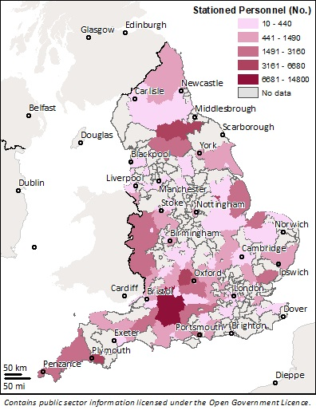
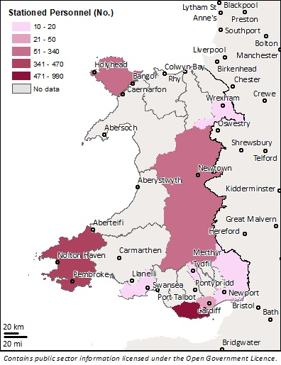
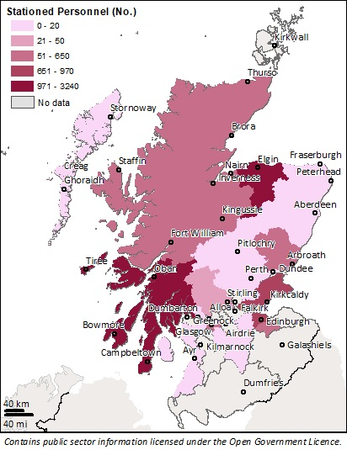
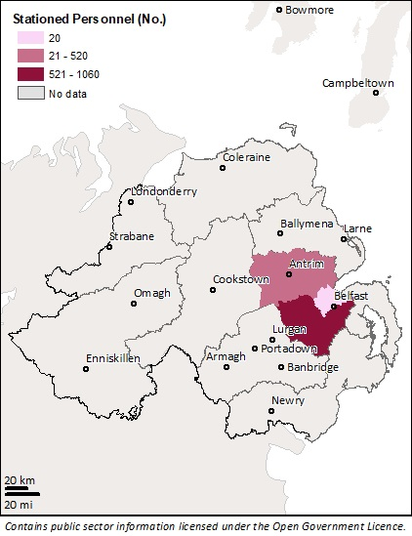
Location of Serving Personnel as a Proxy
England
Wales
Scotland
Northern Ireland
Notes:
Unsurprisingly, top local authority areas in England with the most stationed personnel include Wiltshire where there are multiple military installations, Richmondshire for Catterick Garrison and Portsmouth and Plymouth for Royal Navy and Royal Marines.
Top local authority areas for Wales include Vale of Glamorgan for RAF St Athan and Pembrokeshire for Cawdor Barracks. In sum, these areas align with the main military bases in Wales.
Top local authority areas for Scotland include Argyll and Bute where Naval Base Clyde is at Faslane and Moray where RAF Lossiemouth is.
Data was only available for four local authorities in Northern Ireland due to statistical disclosure control for the other local authorities. Hotspots cover JHC at Aldergrove in Antrim and Newtownabbey.
Using the location of stationed military personnel as a proxy, suggests that these are the main areas where service families live – unsurprisingly, these are also known areas of Service Family Accommodation. It is worth considering that families may live in neighbouring Local Authorities, not necessarily on base and some may live dispersed for increased stability.

Slide 9
Armed Forces HRP Associated Persons 0-15
Source: Census 2011: Armed Forces Household Reference Person (HRP), Associated Persons aged 0-15
England, Wales
Not specific to school age children
Grey areas - no associated persons or very small amount (figures are not available due to statistical disclosure control)
Only households where the HRP is in the Armed Forces
  Potentially only those in the Regular Armed Forces
Local Authority level
Notes:
Can’t pull out school age children from the data or those 16-18.
May be siblings not just children of Armed Forces Personnel
Data apply to England and Wales. No comparable data readily available for Scotland and Northern Ireland.

Slide 10
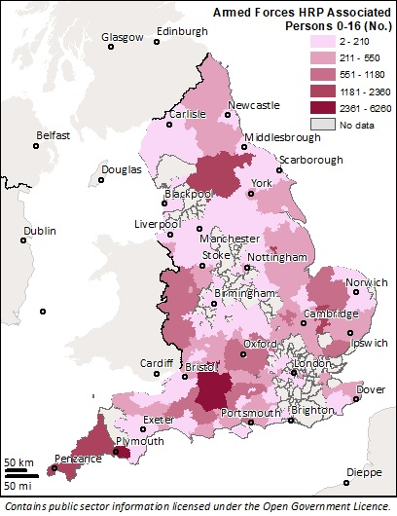
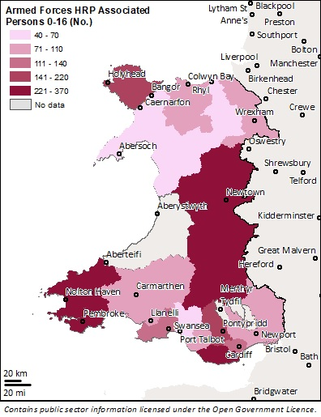
Armed Forces HRP Associated Persons 0-15
 | Top Local Authorities England
1 | Wiltshire
2 | Plymouth
3 | Richmondshire
4 | North Kesteven
5 | Cornwall
6 | Forest Heath
7 | Rushmoor
8 | Gosport
9 | Harrogate
10 | Vale of White Horse
 | Top Local Authorities Wales
1 | Vale of Glamorgan
2 | Powys
3 | Pembrokeshire
4 | Isle of Anglesey
5 | Rhondda Cyon Taf
6 | Cardiff
7 | Swansea
8 | Carmarthenshire
9 | Caerphilly
10 | Monmouthshire
England
Wales

Slide 11
Service Pupil Premium
Source: Service Child Pupil Premium data 2017/18
England ONLY
Data set does not represent:
  Pupils >16
  Children of Reservists or FTRS (Home Commitment)
Parliamentary Constituency and Local Authority level

Slide 12
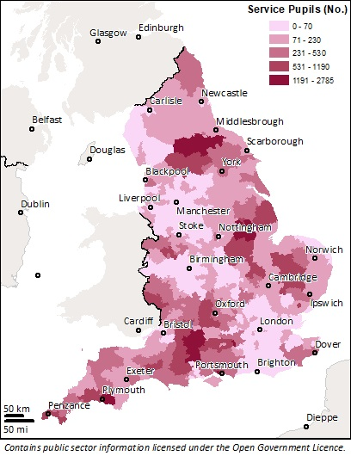
Service Pupil Premium
England
 | Top Parliamentary Constituencies
1 | Devizes
2 | Richmond (Yorkshire)
3 | Sleaford and North Hykeham
4 | Gosport
5 | Aldershot
6 | Salisbury
7 | South West Devon
8 | Plymouth, Moor View
9 | North Wiltshire
10 | Witney
 | Top Local Authorities
1 | Wiltshire
2 | Plymouth
3 | South Kesteven
4 | Fareham
5 | Cornwall
6 | Richmondshire
7 | Hart
8 | South Oxfordshire
9 | Shropshire
10 | Breckland

Slide 13

Why Service Pupil Premium Data?
Most complete dataset
Specifically service children in schools
Includes those living geographically dispersed

Slide 14
Further Education Provision
To consider FE Provision need to focus on key areas
Look at areas most associated with a military presence in UK by service
Using Location statistics top areas:
  Army – Wiltshire
  RAF – West Oxfordshire
  RN & RM – Portsmouth
Southern England Centric, but data led
Overlay FE provision in these LA areas

Slide 15
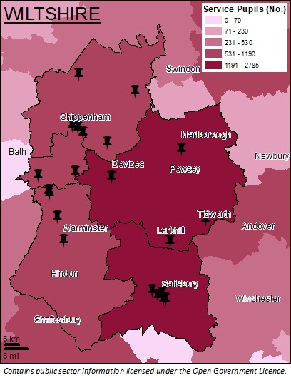

FE Provision: Wiltshire
 | Outstanding | Good | Needs Improvement / Inadequate | Total
Sixth Forms | 5 | 10 | 3 | 20
Colleges | - | 2 | 1 | 3
Independent Schools | 11
Specialist Schools | 7
Main military areas: Tidworth Garrison, Ludgershall, Bulford Camp, Larkhill, RAF Boscombe Down, RAF Winterbourne Gunner and Battlesbury Barracks
3 colleges: Chippenham and Salisbury (inc. UTC)
Wellington Academy, Ludgershall near Ludgershall and Tidworth Garrison
Avon Valley College, Durrington near Larkhill
Kingdown School, Warminster near Battlesbury Barracks
Notes:
Sixth forms – one specific to girls, 1 specific to boys

Slide 16
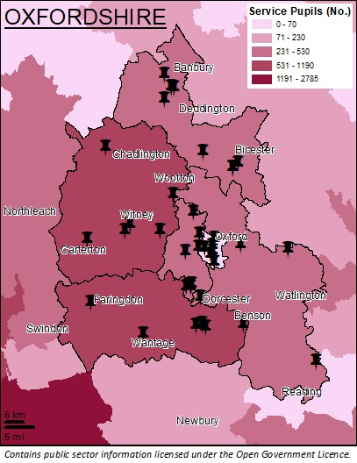

FE Provision: Oxfordshire
 | Outstanding | Good | Needs Improvement / Inadequate | Total
Sixth Forms | 5 | 22 | 4 | 32
Colleges | - | 5 | - | 5
Studio Schools | - | 1 | - | 2
Independent Schools | 23
Specialist Schools | 15
Main military areas: RAF Benson, RAF Brize Norton, Bicester Garrison, Dalton Barracks and Vauxhall Barracks
5 colleges: Oxford, Abingdon, Henley-on-Thames and Didcot (UTC)
Carterton Community College, Carterton near Brize Norton
Wallingford School, Wallingford, near Benson

Slide 17
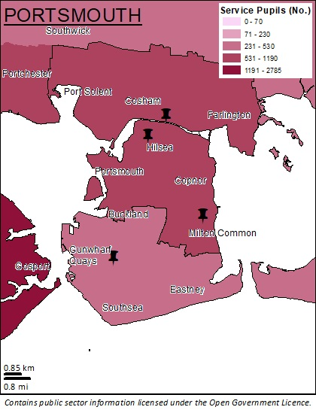

FE Provision: Portsmouth
 | Outstanding | Good | Needs Improvement / Inadequate | Total
Sixth Forms | - | 1 | - | 1
Colleges | - | 1 | 1 | 3
Independent Schools | 3
Specialist Schools | 2
Main military areas: HMNB Portsmouth, HMS Excellent, HMS Temeraire
3 colleges: Cosham, Portsmouth and Hilsea
Ark Charter Academy, Southsea

Slide 18
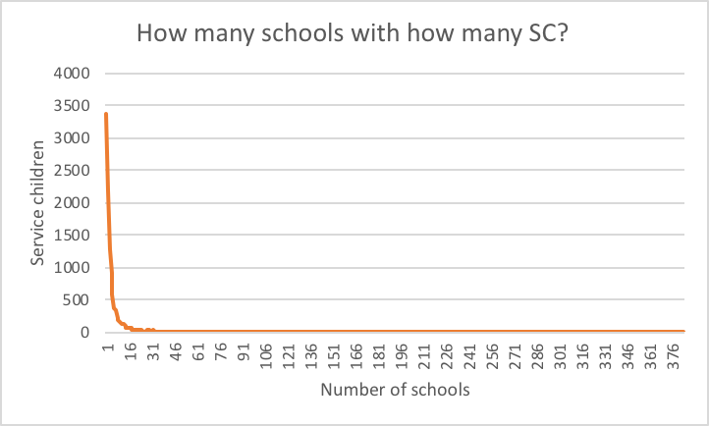
Education
Military presence in an area ≠ understanding of service children in education
Sixth Forms vs. Colleges
Schools Receiving Service Pupil Premium
  31% have one service child
  Half have one or two service children
  87% have <10 service children
  91% have <15 service children
Future Accommodation Model
  Increase in dispersal
Notes:
Living in an area where there is a substantial military presence does not ensure an understanding of service children in education
The Future Accommodation Model and the Flexible Service Policy aims to encourage stability and increase flexibility for military families, moving away from the traditional mobile family. Stability for service children is likely to increase, although the extent of this is unknown.
As a consequence, awareness of students who are service children may decrease as more and more it will reply in them declaring this. Provision will potentially need to spread from concentrated areas to further across the England/UK.
Students lose the extra support provided during secondary education when they move onto further education. The impact of this……

Slide 19
How do we monitor service children’s progression post-16?
How do we increase continuity in education post-16 across the UK?
What can teachers do to support service children post-16?
What can policy makers do?
How do we build a coherent picture?

Slide 20
References
AFF (2016). Compromises of Army Life Survey. Retrieved from: http://www.aff.org.uk/linkedfiles/aff/compromisesofarmylifesurveycommandbrieffinal.pdf
Department for Education (2010) The educational performance of children of Service personnel, https://www.gov.uk/government/uploads/system/uploads/attachment_data/file/182525/DEPARTMENT FOR EDUCATION-RR011.pdf
Department for Education (2014a) Using the Pupil Premium, Service Premium or Early Years Pupil Premium in Admission Arrangements, https://www.gov.uk/government/uploads/system/uploads/attachment_data/file/389464/Pupil_Premium_Admissions_Advice_Dec_2014.pdf
Gibbons, S. and Telhaj, S. (2007) Mobility and School Disruption, London: London School of Economics
House of Commons Defence Committee (2013) The Armed Forces Covenant in Action? Part 3: Educating the Children of Service Personnel: Fourth Report of Session 2013-14, London: The Stationery Office
McCullouch, J. and Hall, M. (2016) Further and Higher Progression for Service Children: Research Paper, https://www.scipalliance.org/assets/files/UoW-research-paper_Further-and-Higher-Progression-for-Service-Children.pdf
National Audit Office (2013) The Education of Service Children: Findings of a National Audit Office Consultation, http://www.nao.org.uk/wp-content/uploads/2013/04/10145-001-The-Education-of-Service-Children.pdf
Ofsted (2011) Children in Service families: the quality and impact of partnership provision for children in Service families, London: Ofsted http://www.ofsted.gov.uk/sites/default/files/documents/surveys-and-good-practice/c/Children%20in%20Service%20families.pdf

