Slide 1


Bridging International Transitions: Mobility Overseas
Mandy Cyprus-Slater,
Acting Principal Educational Psychologist
Directorate Children and Young People, Ministry of Defence
Building Bridges
Winchester June 2017

Slide 2



MOD SCHOOLS
Dunblane
Germany, Netherlands & Belgium, Gibraltar
Naples
Canada
Cyprus
Brunei
Targeted Services DCYP
CEAS
Education Social Workers (4)
Educational Psychologists (4 > 3)
Specialist Advisory Teachers (2)
MOD Schools
Germany – 5 primary schools + 1 secondary
Cyprus – 4 primary + 2 secondary
ROW – 7 schools
Falkland Islands
Many children also around the world and NOT in MOD schools – Kenya, Turkey, Poland, secondary schools in MOD areas etc…

Slide 3
Educational Psychology in the MOD
EP service to MOD schools – training, casework, responsive to issues
Requires travel, flexible working (skype / video / time zones)
Includes SEN plus MOD specific work (eg. mobility and deployments)
Non MOD school areas – limited casework, advice (specific and general), future development area?
Assessments of education supportability overseas (MASO)
UK – liaison with LAs and schools re children transferring and more general aspects.
Joint working with CEAS and DCYP team

Slide 4
My suggestions for effective practice are drawn from:
Review of literature relating to school transitions and the voice of the child (2014)
Small scale research into the views of Secondary and Primary school children about experiences of moving (2014)
MOD / DCYP guidance collected from the experience of colleagues and predecessors.
Current practical experiences working with schools, children and families (recently includes: Brunei, Falklands, Germany, Kenya)

Slide 5

What transitions?
Diverse community – includes families from UK, Nepal, Fiji, Nigeria, Ghana, Kenya, Cameroon, South Africa, Jamaica, India, Germany, Poland….transitions to join!
Regular regiment moves
Trickle postings
Across school phases (vertical transitions)
Friendship groups / teachers / life events (horizontal)
Those left behind…

Slide 6
“Transition” v. “Change”
Change is inevitable – particularly in MOD family context?
Change is situational (Fast)
Transition is the process by which we respond and cope with changes…. It might be positive or negative. Levels of resilience differ.
Transition is psychological (Slow)
Transition
“The process or a period of changing from one state or condition to another. ” (Oxford Dictionary)
“Transitions are the natural process by which humans respond to trauma and change. “ (Dai Williams 1999)

Slide 7
TRANSITION
CHAOS
ENTERING
LEAVING
Anxiety
Status Less
Disengaging
Preparation
Celebration
Denial
Re-engaging
Observation
Introduction
Vulnerability
RE-INVOLVEMENT
INVOLVEMENT
Settled
Commitment
Status
Intimacy
Settled
Commitment
Status
Intimacy
The Transition Experience

Slide 8
Vygotsky (1978) Sociocultural Theory
Development of human thought and action is influenced by the social and cultural context.
Development
Culture
Language
Social Interactions

Slide 9

Year 6 – 7 Transition themes (Ashton 2008):
Mixed feelings
Friends
Getting lost
Race
Sole children
Teachers
Growing Up
School choice
Experience of high school
Curriculum and work
“Learning issues were rarely raised, suggesting that the social aspects of the move are most important for children at the end of Year 6”

Slide 10

Horizontal transitions (Pietarinen et al 2010)
“pupils considered the kinds of transitions that challenge their sense of belonging in the school community highly significant”
“transitions that challenged the pupils’ sense of belonging were often situated in the social conflicts ... processing the social conflicts was considered as a crucial precondition for constructing the sense of belonging in the school community….However, according to the pupil’s experiences, a need to promote the learning outcomes often seems to override the social aims of schooling”

Slide 11

Secondary students reflecting on previous moves:
WHAT HELPS?
“Don’t feel you have to change”
“Take on challenges in the new school”
“Parents helped to reassure me – they said its better here (in UK) and we can see our family”
Preparation such as looking on school websites, reassurance from parents
“Don’t be scared” (year 7 pupil)
“We are used to moving, just get on with it”
“I went to a school in Kenya and felt isolated. I got fat and this made me depressed. I had an eating disorder and I lost weight.”
“I was depressed in the UK school as my skills were not improving – my parents were worried about school.”

Slide 12

Primary children looking ahead to a move to the UK:
Will miss friends (4)
A bit anxious about new school (2)
“Dad never knows when he is going to move again” (1)
WHAT HELPS?
Making friends quickly at new school
Knowing about new school (in advance)
Seeing the new school
Having a “buddy”
Being able to say goodbye to friends – suggested sweets, presents, photos to take, leave a toy with a friend

Slide 13



BALANCE

Slide 14


Good practice -
Prepare for moving; support Joiners and Leavers.
Information Sharing between settings about abilities, attainments and any outside agency work.
- For all MOD pupils - Pupil Information Profile (PIP)
- Also, for MOD pupils with SEN – Transfer of Information Pack
Consider the voice of the child
Reflect on the transition experience and positives
(All areas we can consider further after main presentation?)

Slide 15
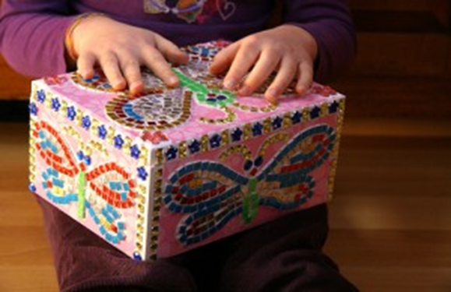


Preparing for Moving
Create opportunities for pupils to talk about their experiences of moving
Create opportunities to make and keep memories
Be cognizant of the transition cycle, the time scales and emotional upheaval that can be involved
Look out for signs of separation anxiety
Read relevant literature….The Third Culture Kid Experience is highly recommended

Slide 16

Helping "Leavers"
Keep accurate records of progress and current targets
Share Transition Documents
Help resolve any conflicts with other pupils
Plan farewell rituals
Affirm relationships and achievements
Think positively about the future
Speak to the new school about strategies they could put in place to help child to settle i.e buddy system
Establish an E-mail link with a pupil in the new school
If possible visit the new school either in person or via VTC
Look at new schools web site

Slide 17


Helping "Joiners"
Have an induction pack which pupils have helped to prepare
Have information for parents about your class
Nominate other pupils to be mentors / buddies for new arrivals
Encourage pupils to talk about where they have been and share memories

Slide 18
INFORMATION SHARING TOOLS

Slide 21
FRONT PAGE
BACK PAGE

Slide 23
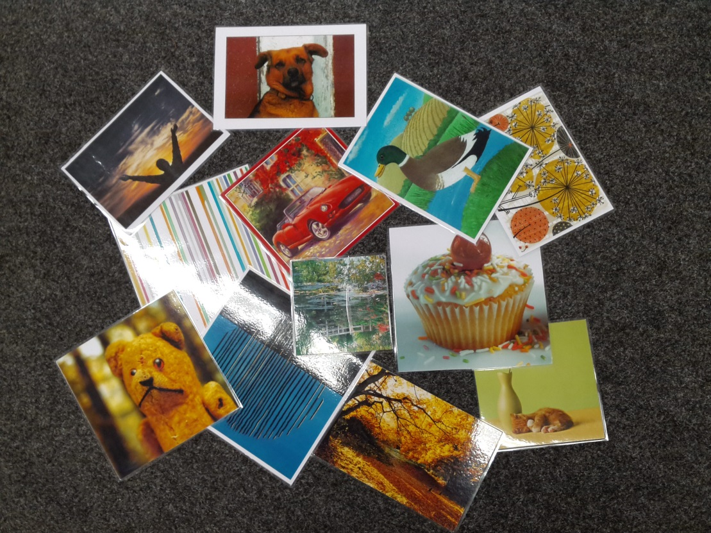
VOICE OF THE CHILD
Using pictures to gain richer information

Slide 24
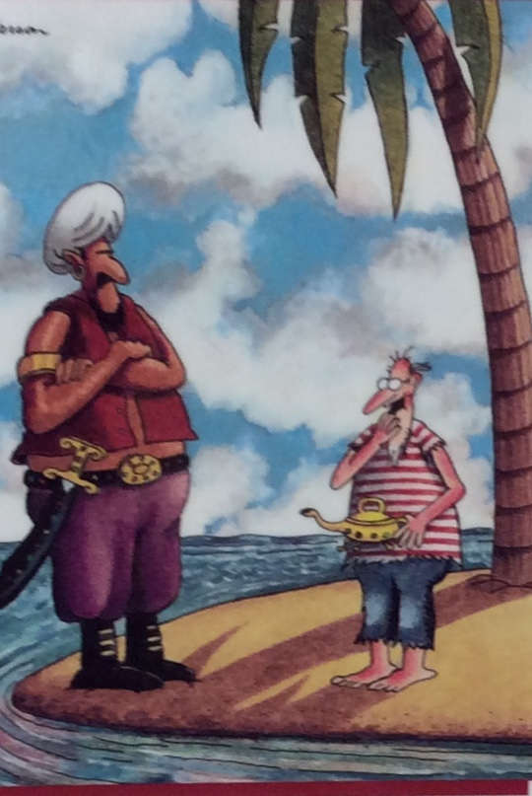

I had no control over decision making.
New school in UK felt like a desert island. Only there for a year, not worth making the effort.
Was asked why I didn’t speak German and was called “German” in primary school
I felt alone and empty when I came to this school.

Slide 25


This tree tells me that I am feeling more at ease here.
Worst thing was going into UK school in the middle of term – felt scared and didn’t have any friends.
The leaves remind me of feeling free. I am a loner, I don’t need people.

Slide 26
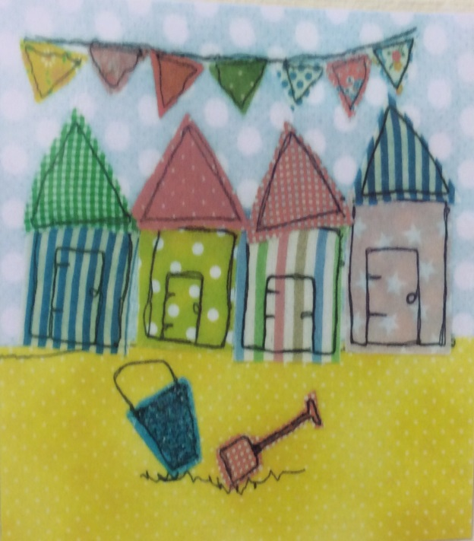

I was part of decision making process – parents discussed with me before we moved. Which school I went to.
This is like the time when we were preparing to move here and it was a very confusing time. It felt like this.

Slide 27


The bears make me feel happy and remind me of the happy memories I can take with me
There’s a lot going on in this picture. When we are getting reading to move, packing, there’s a lot going on.

Slide 28
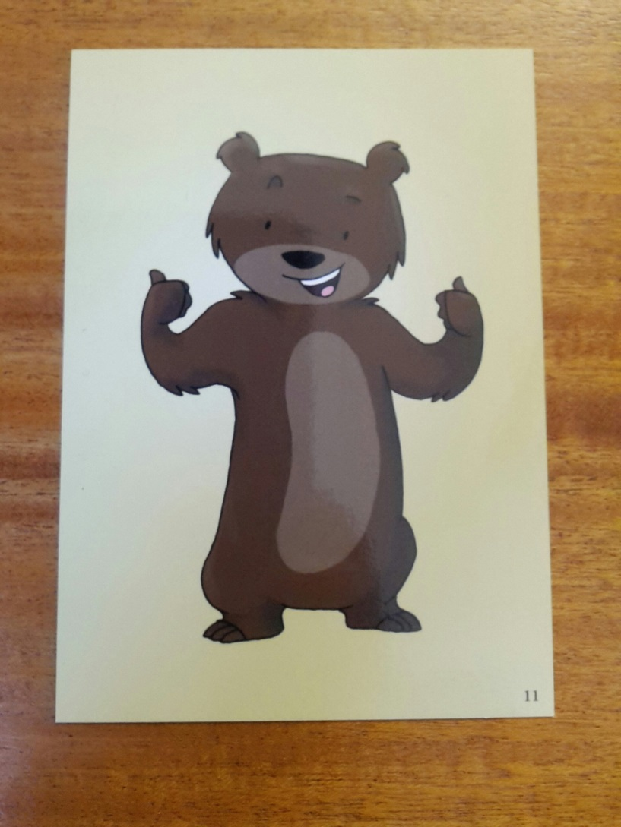
Bear card 11
“I have had 7 schools up ‘til now” (Y6 girl)
“All exciting stuff…new friends and meeting cousins”

Slide 29
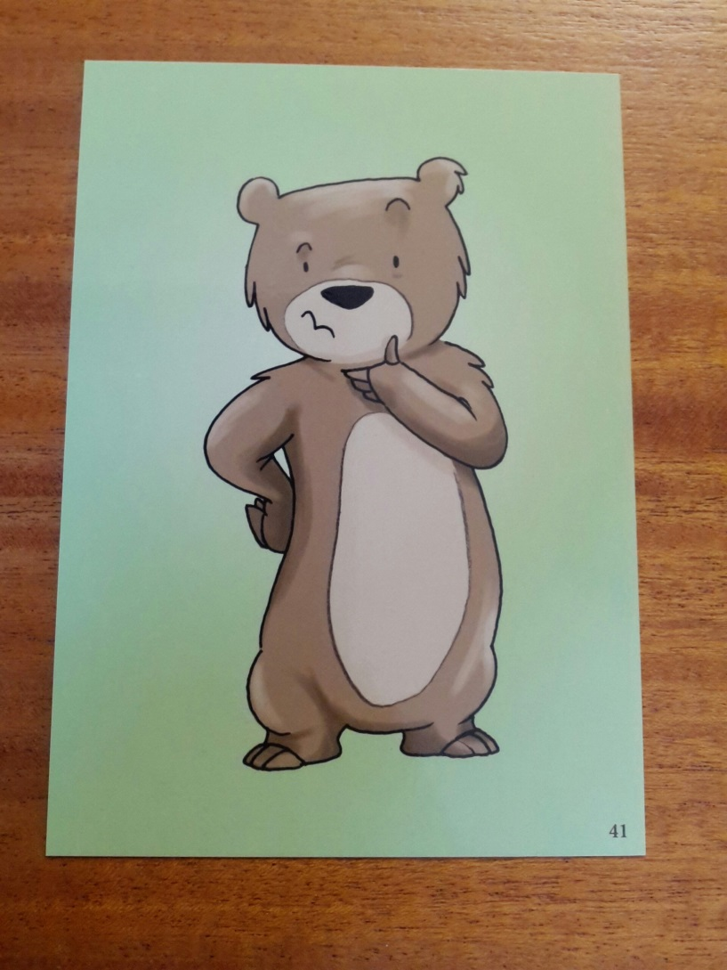
Bear card 41
“Starting another school again, really good school though!” Boy Y6
“Not sure if you want to move” Girl Y2

Slide 30
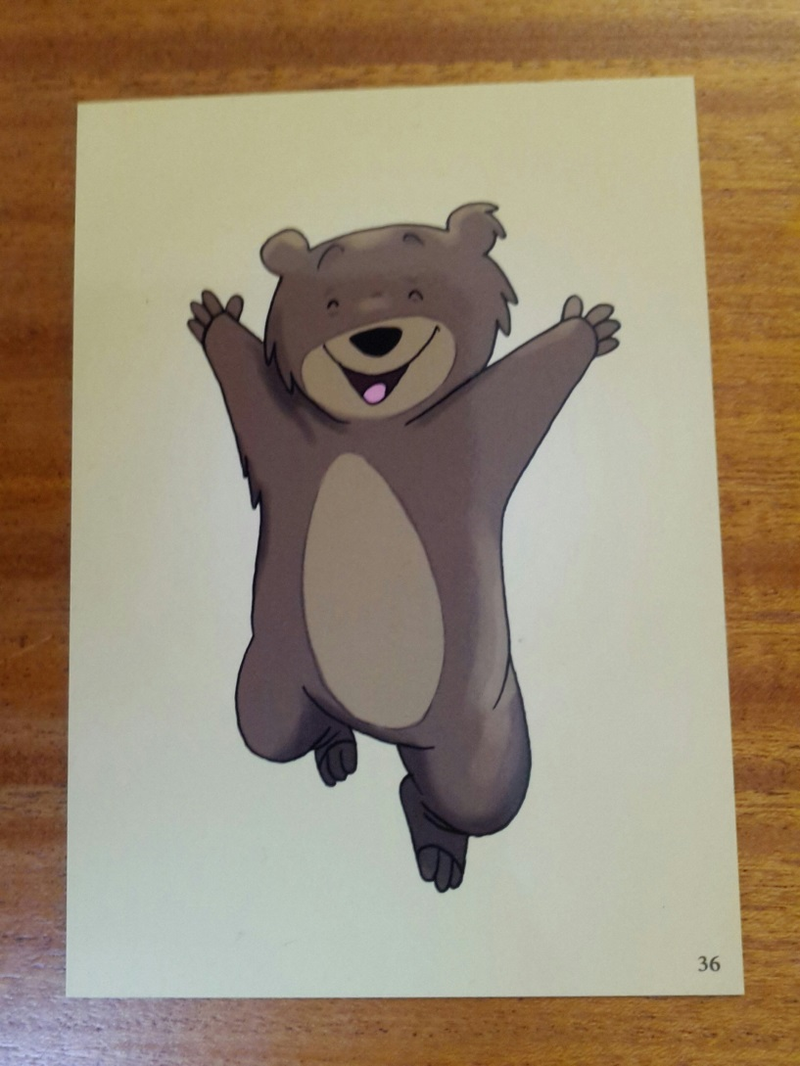
Bear card 36
“I’m so excited” Girl Y2

Slide 31
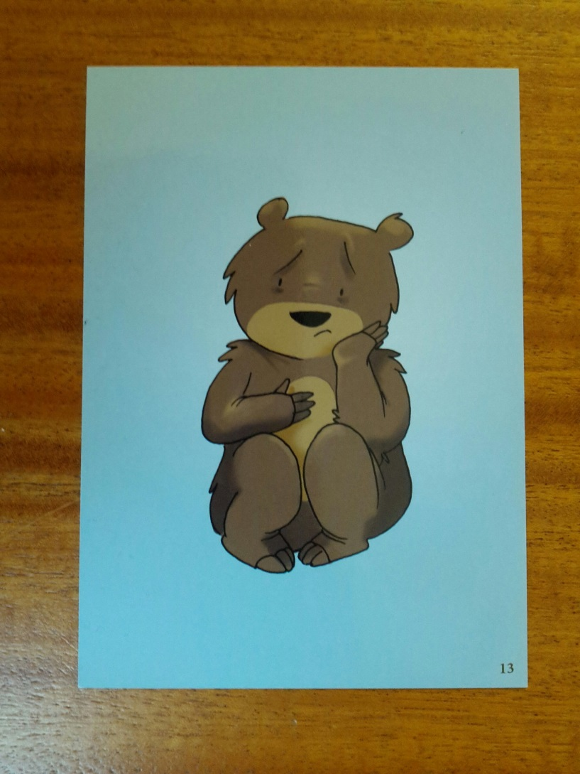
Bear card 13
“Sad.. miss friends” Girl Y2

Slide 32
REFLECTING ON TRANSITION

Slide 33
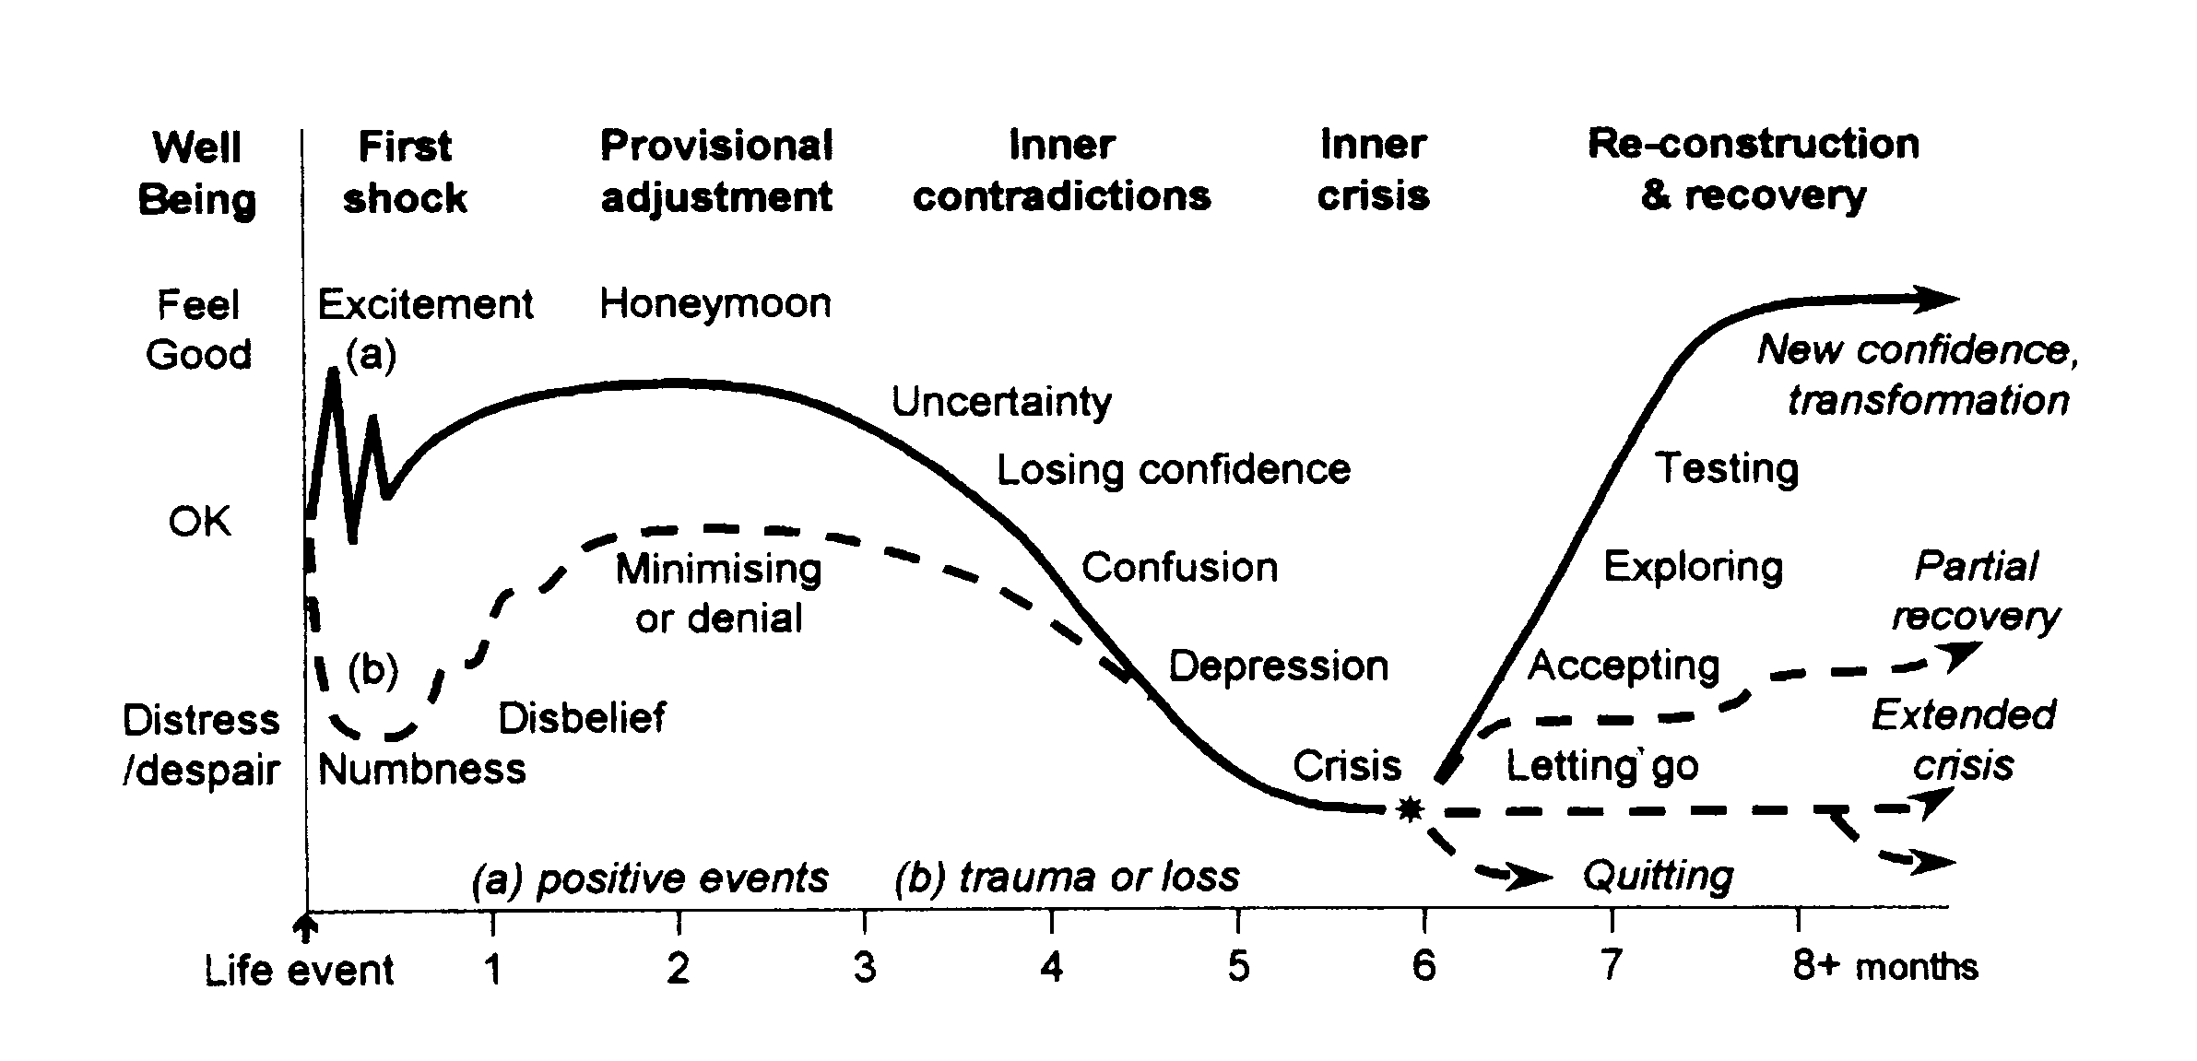
The Transition Cycle (Dai Williams 1999)

