Slide 1


Thriving lives for Service children
1
Our approach is clear
Leaders’ understanding and approach ensure resources and policies improve Service children’s outcomes.
Notes:
In this presentation, we will explore the need for clear and transparent representation, expenditure and support for Service children in education. ‘Our approach is clear’ is Principle 1 of the Service Children’s Progression Alliance Thriving Lives Toolkit for schools.

Slide 2

1
Our approach is clear
2
wellbeing is supported
3
Achievement is maximised
4
Transition is effective
THE 7 PRINCIPLES OF EFFECTIVE SUPPORT
5
Children are heard
6
Parents are engaged
7
Staff are well-informed
Notes:
The research underpinning the SCiP Alliance Thriving Lives Toolkit highlighted the importance of a strategic and transparent school leadership approach and identified effective strategies, such as targeted deployment of resources and a whole-school approach.

Slide 3
Leaders’ understanding and approach ensure resources and policies improve Service children’s outcomes.
1
Our approach is clear

Slide 4

AFTER COMPLETING THIS PRESENTATION, EDUCATION PROFESSIONALS WILL :
Have a deeper understanding of the context for Service children
Have explored what this means for schools and how the Armed Forces Covenant applies in schools
  Have reflected on how schools can develop clear and supportive policies in areas such as admissions and governance and effectively deploy resources and dedicated funding
Notes:
After using this presentation, you will have a deeper understanding of the context for Service children, what this means for schools and how the Armed Forces Covenant applies in an educational context. You will understand the evidence base around effective leadership strategies for supporting Service children in education. And you will reflect on the role of those responsible for school governance in ensuring that the education and welfare of Service children is given a specific focus and that outcomes are carefully monitored in order to evaluate and develop effective support.

Slide 5

THIS PRESENTATION:
The context for Service children
How can schools support Service children?
Where can schools get help?
Notes:
This presentation is organised into three sections. We will explore the context for Service children’s lives, learn how schools can support them and then look at who can help schools help Service children.

Slide 6
SECTION 1:
The context for Service children
1
Our approach is clear
Notes:
Service children are individuals, whose family lifestyle may present a unique set of educational challenges and opportunities.

Slide 7
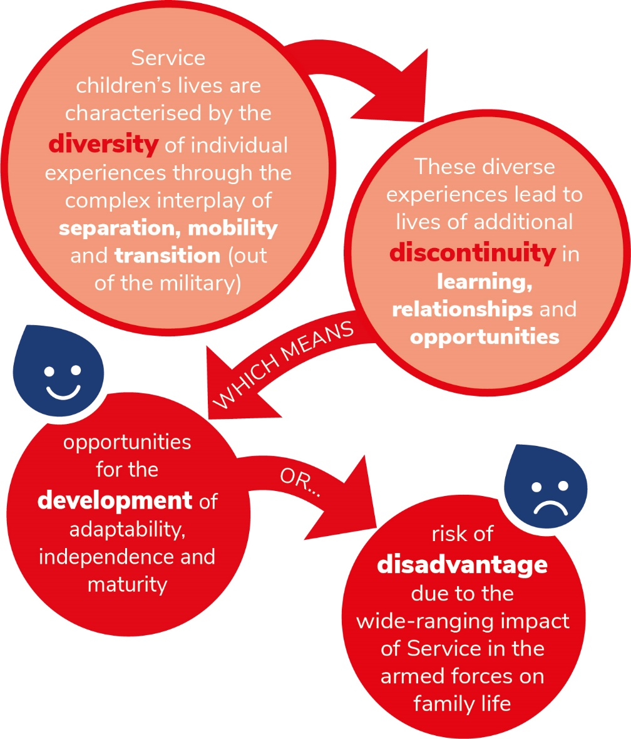
THE FOUR Ds OF SERVICE CHILDREN’S LIVES
Notes:
The SCiP Alliance theory of change identifies four characteristics of Service children’s lives, summarise in four Ds:
Diversity of experience through the complex interplay of separation, mobility and transition
Which can lead to...
Discontinuity in learning, discontinuity in relationships, discontinuity in opportunities
Which can provide opportunities for the...
Development of adaptability, independence and maturity
But can also create the...
Risk of Disadvantage

Slide 8


THE ARMED FORCES COVENANT
‘The Armed Forces Covenant is a promise by the nation that those who serve, or who have served, in the armed forces, and their families, are treated fairly.’
Notes:
The Armed Forces Covenant is a promise by the nation that those who serve or who have served in the armed forces, and their families, are treated with fairness and respect and have the same access to government and commercial services and products as any other citizen, including in education and family well-being.
The Covenant is not about giving special treatment to Armed Forces families to provide an advantage; but about identifying barriers which may lead to disadvantage and finding ways of overcoming these.
The Covenant is an informal understanding - but it is nevertheless treated with great seriousness within the Armed Forces and by the government. As such, every school which has even one pupil from an Armed Forces family should be aware of their obligations to the Covenant.
Schools can sign up to the Covenant themselves. They can also participate in the Ministry of Defence’s Employer Recognition Scheme which has three levels of recognition; particularly relevant if a school is sited near to a military base offering work opportunities for Armed Forces personnel’s partners.

Slide 9
SECTION 2:
What does this mean for schools?
1
Our approach is clear
Notes:
We will now explore what this unique context means for schools.

Slide 10
THE IMPLICATIONS FOR STAFF TRAINING
The whole school needs to be aware of the context for your specific Service population e.g.
Transition, deployment, R&R and ‘weekending’
Potential impacts on educational progression
Rank and a unit’s role
Characteristics of caring roles in Armed Forces families
Also see:
Principle 2 (Well-being)
Principle 4 (Transition)
Principle 7 (Well-informed staff)
Notes:
Evidence suggests that clear policies and strong cultural awareness of the life of the Service child at a strategic level, are critical. Successful school policies ensure that all staff who come into contact with Service children not only know who these pupils are, but also, at a minimum, understand the challenges and potential impacts of regular school to school transition, a parent’s operational deployment and aspects of lifestyle such as ‘weekending’ or periods of ‘Rest and Recuperation’.
These are explored in detail in the professional development materials associated with Principles 3, Transition is Effective (school-to-school mobility) and 2, Well-being is Supported (covering deployment). Having well-informed staff is the theme of Principle 7 of the Thriving Lives Toolkit.

Slide 11
Potential challenges for young people from Armed Forces families: CURRICULUM
Discontinuity such as:
  Repeating topics
  Missing units of work
  Unavailable exam courses
  Different exam boards
  Access to enrichment opportunities
  Different education systems, structures and language
Notes:
Service children may face disadvantage when frequent school moves lead to gaps or repetition of school topics, or when national examination courses cannot be continued or require a change of exam board. This can be particularly the case when children move to and from overseas locations to the UK, or between England, Scotland, Wales and Northern Ireland. Policies to mitigate such curriculum discontinuity are crucial.

Slide 12
Potential challenges for young people from Armed Forces families: ACCESS
High mobility, often in-year or at short notice, between Wales, Scotland, Northern Ireland and England.
  Different education systems, exam structures, year groups
  Welsh language in Wales
Challenges accessing early years provision and wrap-around care
  Applying for places at short notice
  National policies may not match Service families’ circumstances
Risk of disadvantage:
  Siblings may be allocated to different schools
  Class size regulations and over-subscription criteria
  Lack of a permanent home address in the area to apply for a school place until quarters are allocated on arrival
  Different foreign language subject options
Notes:
Service families may move at short notice with no control over location or timing. The regional and national differences in school admissions, further complicated by different processes for different types of school, can have a particularly high impact on Service families, especially when they need in-year school places, pre-school provision, or before and after school care. Families moving to Wales may experience the added complexity of Welsh language teaching. The Ministry of Defence and the three Services’ Families Federations are being proactive in addressing these issues, for example by working with schools to enable them to recognise a unit address rather than having to wait until quarters have been allocated. Some national policies may not work for Service families, for whom, for example, spousal employment may be impossible due to high mobility.
Effective schools consider how they can embody the Armed Forces Covenant through their policies. English schools with responsibility for admissions can do this through their specific admissions policies within admissions guidance, for example by considering Service children for exceptional in-year admission.

Slide 13
Potential challenges for young people from Armed Forces families: WELLBEING
Service children may need extra support during:
  Transition (between schools and when a parent is leaving the Armed Forces)
  Deployment
  Separation
Potential barriers to accessing wider support mechanisms
Need to reflect and share experiences
Higher incidence of caring responsibilities
Lack of opportunities to have their voices heard and listened to
Notes:
Service children may need extra support during:
Mobility and transition (which to an Armed Forces family may mean the transition of a parent out of the military)
Deployment or
Separation
They may struggle to access extra-curricular opportunities or sustained programmes of support for SEND or Additional Support for Learning, careers guidance or outreach due to high mobility and a higher incidence of caring responsibilities. Research by the Children’s Society found that “At both strategic level and in welfare provision, young carers in armed forces families are a hidden group of children and young people”.
Effective schools plan to mitigate these potential areas of disadvantage and for Service children to have opportunities to reflect and share their experiences.

Slide 14
SECTION 3:
How can schools support Service children?
1
Our approach is clear
Notes:
Clear strategies are crucial to ensuring schools are able to make the most of the opportunities available to their Service children and mitigate any potential challenges in a planned and transparent way.

Slide 15

COMMUNICATION AND TRANSPARENCY
  Effective schools focus on:
  Explicit reference to Service children in reports and governance documents
  Specific reference and welcome on school websites
  Effective monitoring and evaluation of policies’ impact
  Embedded Service child voice
  Clear policies and reporting around use of targeted funding
Notes:
The research underpinning the Thriving Lives Toolkit found that schools with effective provision for Service children tended to have clear systems in place understood by all, including welcoming references to their Armed Forces families on their websites. While it is true that, like all parents, those associated with the Armed Forces are interested in inspection judgements and academic outcomes when choosing a school, the evidence suggests that they seek out schools who show an understanding of their lifestyle too.

Slide 16

TARGETED RESOURCES
  Effective schools focus on:
  Clear, published strategies:
  Bidding for bespoke project funding
    Using and evaluating targeted funding
    Collaborating to maximise opportunities for Service children
    Learning from case studies of other schools’ approaches
    Access to appropriate age-related resources
    Identifying a named member of staff to oversee this.
SSCE Cymru School Toolkit
Notes:
Effective schools make the most of sources of external funding for Service children and have a clear published strategy for bidding for, delivering and evaluating these projects. English schools in receipt of Service Pupil Premium plan evidence-based, tailored programmes of support and account for this separately to Pupil Premium. Across the UK, schools can plan targeted support by bidding for grant funding from funds such as Ministry of Defence DCYP education funding, the Armed Forces Covenant Fund Trust or specific local funds in some areas.
Case studies of a variety of school approaches have been published by organisations supporting those who work with Service children such as the MoD, the SCiP Alliance and SSCE Cymru. SSCE Cymru has produced detailed guidance for schools on making the most of funding applications.

Slide 17
MONITORING IMPACT
Robust tracking and outcome monitoring
  Academic
  Attendance
  Health and wellbeing measures
The importance of reporting on Service children’s outcomes
  Parental engagement
  Governance
  Spotting trends and gaps
  Evidencing impact and laying foundations for future targeted support
Notes:
Effective schools consider the impact of strategies and any dedicated spending. Leaders in schools with Service children on roll can ensure that their tracking systems compare the outcomes for this group of children alongside the characteristics that most schools consider, such as gender or Additional Support Needs. This includes the tracking and comparison of not just of academic outcomes, but attendance, behaviour incidents and any health and wellbeing indicators schools may measure. Tracking and reporting in this way, such as in Headteachers’ reports, facilitates whole school and community buy-in to intervention strategies and builds relationships with parents. Robust impact evaluation of the use of any targeted funding is particularly important for schools considering bidding for further funding in the future.

Slide 18
CRITICAL OVERSIGHT
Effective schools ensure that the bodies to which they are accountable, such as Parent Councils in Scotland or trustees and governor boards pay specific attention to Service children when discharging responsibilities such as:
  Setting strategic direction
  Creating robust accountability
  Ensuring financial probity
Notes:
Research shows that effective schools train members of governing bodies or parent councils in the specific context for Service children and ensure robust monitoring and questioning on a regular basis with specific reference to the school’s Service child population. This includes setting strategy for and monitoring of expenditure or grants where appropriate.

Slide 19
SECTION 4:
Where can schools get help?
1
Our approach is clear
Notes:
We will now look at who can help schools help Service children.

Slide 20



SIGNPOSTING TO DCYP
Children’s Education Advisory Service
Web links:
Children’s Education Advisory Service (CEAS)
Directorate of Children & Young People (DCYP)
Notes:
DCYP is the lead organisation for Service children’s education and welfare and sets strategic direction and policy to ensure provision of high quality education for all Service children.
CEAS, part of DCYP, can provide advice and guidance on specific concerns. You can call or email them with specific questions about Service children’s needs and your work supporting them. You can also signpost parents with specific queries related to their Service to CEAS. It is a tri-service organisation which aims to:
‘Support operational effectiveness of the Armed Forces by enabling service and eligible MOD civilian families to secure appropriate provision for their children and to develop strategies to mitigate the impact of mobility and deployment.’
Admissions advice from CEAS should be sought by all Armed Forces parents with children with Education Health and Care Plans or the equivalent, and any Service family facing issues such as admissions appeals should be signposted to CEAS. It is mandatory for Army personnel to inform CEAS of their children’s support needs, whereas RAF and Naval personnel are not obliged to disclose whether their child has additional support needs.
Principle 1: A Clear Approach includes an expectation that school leaders are familiar with CEAS and the role it and the wider DCYP plays in supporting Service families, signposting parents as appropriate.

Slide 21

HELP FROM THE SCIP ALLIANCE
www.scipalliance.org provides links to:
Resources
Case studies of school practice
A Hub Network
Others who may be able to help
Notes:
The SCiP Alliance website provides an information and signposting Hub; this presentation is part of a CPD database which also contains case studies of school practice.

Slide 22




Schools can reach out to support and networks
Families Federations
SCiP Alliance Hubs
Supporting Service Children in Education Cymru (Wales)
Royal Caledonian Education Trust (Scotland)
Service Children in State Schools (England)
Notes:
These organisations, and others, have experience and expertise in setting and monitoring strategic support for Service children. Reach out too to other schools in your area and look for opportunities for networking and sharing experience – many local authorities and the organisations listed here organise conferences and networking events.

Slide 23
SUMMARY
The Armed Forces Covenant was introduced to tackle disadvantage; clear policies and strong cultural awareness are key to effective support and mitigation.
Notes:
In this presentation we have considered the evidence that points to the need for schools to have clear and transparent representation, expenditure and support for their Service children. This includes understanding the expectations of the Armed Forces Covenant.

Slide 24

SUMMARY
The four Ds of Service children’s lives:
  Diversity
  Discontinuity
  Development
  Disadvantage
Notes:
A reminder of why a clear approach is important.

Slide 25
SUMMARY
Clear policies and strong cultural awareness of the life of a Service child at a school’s strategic level are key to effective support.
A central aspect of school transparency and support is the targeted deployment of resources, including dedicated funding where available.
Monitoring Service children’s outcomes and the impact of spend and activity can improve the effectiveness of support.
Notes:
Policies, practices and dedicated expenditure need to be shared with key stakeholders, especially parents, and to be scrutinised robustly by governing bodies.

Slide 26
FURTHER READING and SOURCES OF SUPPORT
  Burke et al (2019) Supporting Service Children in School: An organisational Improvement Framework
  https://www.gov.uk/government/groups/directorate-children-and-young-people
  www.armedforcescovenant.gov.uk
  www.forceschildreseducation.scot
  www.scipalliance.org
  SSCE Cymru School Toolkit (https://www.sscecymru.co.uk/toolkits/schooltoolkit/default.htm)
  Children’s Society (2017) Young Carers in Armed Forces Families (https://www.scipalliance.org/assets/files/The-Childrens-Society-Young-Carers-in-Armed-Forces-Families.pdf)

Slide 27






WITH THANKS TO:
This module has been developed by the Service Children’s Progression Alliance with help from…
Ceri Cusack, Military wife, mother and special needs teacher
Grahame Shepherd, retired Headteacher and former Chair of Service Children in State Schools National Executive Advisory Committee
Matt Blyton, Senior Education Adviser, North Yorkshire County Council
Millie Taylor, Programme Manager, SSCE Cymru
Moira Leslie, Education Manager, Royal Caledonian Education Trust
Project schools: NCOP-SCiP Alliance research and organisational framework project (2019)
William Burchill, Admissions Manager, North Yorkshire County Council
Funded by…

