Slide 1
Common threads and different contexts through mobility, separation and transition
Service Life
Notes:
Good afternoon, we have been invited to provide an introduction to the common threads and differences that children from Armed Forces families experience during childhood and adolescence.
The FFs provide an independent voice for the families of Regular and Reserve personnel and work to remove disadvantage arising from military service. We help families with advice and practical support across a range of issues, as well as working for change with politicians, the Chain of Command and policy makers in the British Government and across the Devolved Administrations. We hear from families on a daily basis about their lived experience.
Service children experience many of the same joys and challenges as other children, but they can experience additional layers of complexity. These can be as a result of:
frequent moves involving changes of home, school and friendship groups
prolonged and unpredictable periods of separation from parents (sometimes involving significant risk to mum or dad)
and the eventual transition of a serving parent or parents into civilian life.
We thought that we would approach this by introducing you to 3 different children, whose stories are based on the real-life experiences of children we have met through our work. Just as all children and families are unique, each Service child will have his or her own story, but you may notice some common themes.

Slide 2
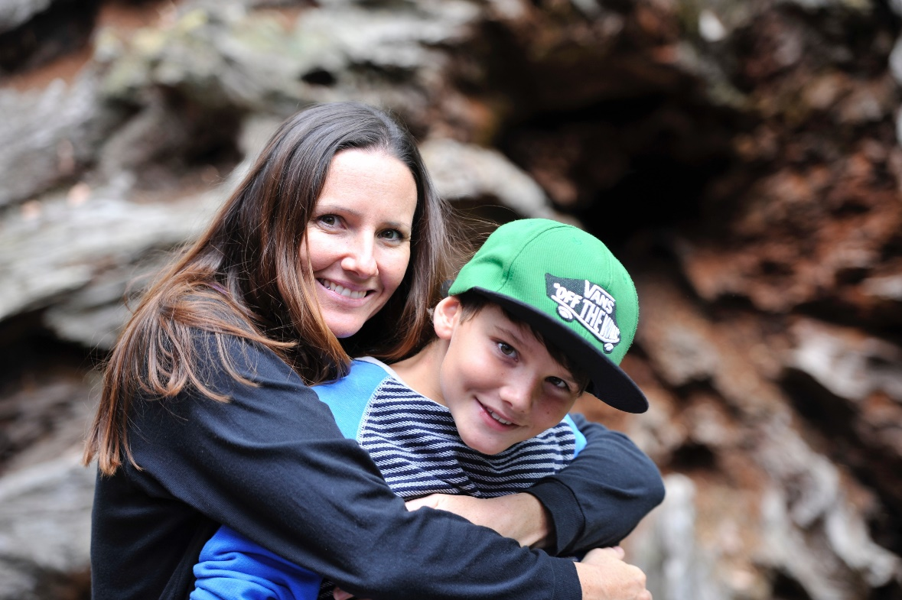
Zac (a hypothetical case study)
Mobility
Overseas
Single parent
Admissions
Deployment
Multiple carers/guardians
Notes:
My name is Zachary, I am in Year 6. I love my School and have been here for the past 2 years. I have been to 2 other primaries since I started school. When I moved from Germany back to the UK I got to move with lots of other families at the same time and some of us ended up in the same school. It was strange having a new school again, I think when I was younger I found it easier as Mum just told me we were moving and I was happy because we got to stay together. Our dog, Fudge, came to Germany with us. I liked it there we had lots of fun and our next door neighbour kept chickens. Sunday’s were seen as family days and Mum, Fudge and I got to spend lots of time together and we tried to learn some of the language together too.
When we came back to England we had a new house and it felt strange but it was nice that Mum and I had people who we knew experiencing it with us. I mostly liked it when Mum wanted to do dome unpacking and sorting she’d tell me to ‘go out and play’ and because I already knew some of the other children I could do just that! The worst thing was that Mum got really worried about getting me a school place because there were lots of people applying at the same time; some of the schools were already full when we started applying. One night I heard her crying to Aunty Jen on the phone as she thought it was all her fault and that it wasn’t fair to me. In the end, even though I was on a waiting list for the local school Mum got a phone call the day before term started to say I had a place. We had to rush around getting me ready, the school were really kind and told Mum and I not to worry that I didn’t have the right school uniform to start with. I didn’t like being different to the other children and I was relived when my jumper and polo shirt arrived a week later!
And now I am getting ready for another new school.
My friends are all applying for their secondary schools and are getting excited and nervous together. I won’t be going with them as Mum is due to be going away for 6 months and I am going to go and live with my Aunty Jen. Where Aunty Jen lives they have middle schools and I will be going in to a Year 7 with children who have been at the same school already for 2 years. I had to live with Aunty Jen once before and I often have to go and stay when Mum has to work away for days at a time. When it’s during school time I have to have sleepovers with friends or sometimes Grandad can come and stay to look after me when he isn’t working. Mum is always having to plan and make arrangements for me. I wish I was older so she didn’t have to worry about me. Mum says that when she comes back everything will go back to normal and I will live with her again. However Mum won’t be sent to a job that is anywhere near Aunty Jen so I will be moving to yet another new school and a new house too.
Mum loves her job and I am proud of her. I like having lots of friends, some move away but then new ones come along and you get to make even more. I think I’m good at looking after myself because Mum works long days so I often walk to school on my own and always have to stay at after-school club but now I’m in Year 6 we get to help look after the little kids and I like doing that. Mum always talks about our ‘Forever House’, the home we will have ‘one day’ and we spend a lot of time talking about what we’ll have in it. I really would like some chickens, Mum isn’t so sure! Then again, it won’t happen, I can’t imagine what being in one place for a long time would be like and I don’t think Mum can either.

Slide 3
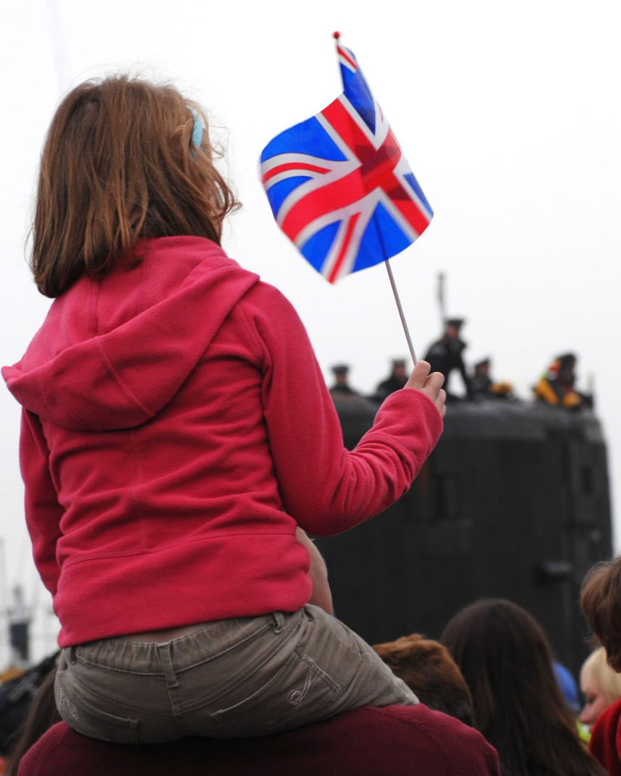
Freya (a hypothetical case study)
Separation
Deployment
Lack of contact
Relationships
Mental health
Young Carer
Transition (to civilian life)
Crown Copyright 2007 credit LA(Phot) K McAlinden
Notes:
My name is Freya and I am starting big school today. My mum is taking me. We took some pictures to show daddy when he gets home [separation] at Christmas. He is working under the sea in a submarine with his friends [deployment]. We can't phone him until the submarine comes back up [lack of contact] because where he is is a big secret and phones make a lot of noise.
I am in Year 1. My new teacher is Miss Jones and she has a pet snail in a tank. In singing assembly Mrs Ellis said the mummies and daddies are coming in after school to look at our work. My daddy can't come but mummy says she will ask if I can take my owl picture home to show him on Facetime.
Daddy is home on leave. He came to pick me up from school today but he was waiting by the wrong door and Mrs Ellis had to come in and find me. Silly daddy!
I'm in Juniors now and my sisters are starting in Reception. They look funny in their big uniforms. Mummy got sad that daddy wasn't there but I gave her a cuddle and she said I was a really good big sister. I heard mummy crying on the phone when I was in bed. She and daddy were having a fight about us moving to Scotland to live so we can see him more. I don't want to move because my friends are here but I don't want mummy to be sad [relationships].
Dad is home on leave for 3 whole weeks! We are going to Alton Towers and I am tall enough to go on the Nemesis. We had a big talk and have decided that we are going to move to a house near here, even though dad is still mainly working in Scotland. That way me and my sisters can get into a good school for year 7 and mum can keep her job.
Dad is trying to fly home at the weekends when he is not away at sea. When he gets home he is tired. I take my sisters out on their bikes to the park. I don't like him very much when he comes home. He tells me what to do all the time. Sometimes I wish he would just stay in Scotland and then I feel bad. Mum says he loves me but he's never here and he doesn't know anything about my friends or what I like to do. I think he cares more about his job and his friends than he does about me.
Mum went to the doctor. The doctor said she has depression [mental health]. She doesn't really want to go out and meet people so I get my sisters from school when dad is away [Young Carer]. Then I make the tea. I wanted to move up to Rangers this term but I can't ask mum to drive me there. I feel sad and a bit cross with mum. My friends all get to go and do things with their dads. I said this to mum and she just laughed a bit and said try being married to him.
Dad is leaving the Navy [Transition]. This means he will be at home ALL THE TIME, going on about me leaving my shoes in the wrong places and telling me to get off my phone. I hope he can get a job. Maybe we can go and do things as a family and my mum will be happier. I don't know what it's going to be like. I'll probably have to GET OUT OF BED and do star jumps in the garden...I think it will be okay though. Maybe we will get a dog now.

Slide 4
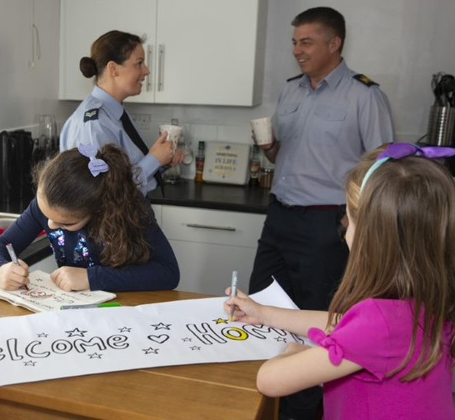
Sarah (a hypothetical case study)
Dual Serving families
Mobility
Devolved administrations
Separation
Curriculum
SEND
©Crown Copyright2019 (SAC K Waterson)
Transition (to civilian life)
Notes:
Both my parents work in the Forces. For as long as I can remember. It’s funny because no one ever expects that both your mum and dad will turn up in uniform but I am dead proud of them.
We’ve mostly always lived on the patch in military houses and I’ve moved quite a lot of times. I’ve got used to it I suppose – I like meeting new people now and I can make friends pretty quickly but I always miss my old friends like mad at first and it can be tough always being the kid that’s moving away – people treat you differently once they know you are going. Sometimes I have lots of other military kids at school which helps a bit, but other times I am one of the only ones which feels a bit different. Sometimes we all live together and other times I live all the time with mum or dad and we all get together at weekends.
I lived in Scotland for a while – I liked it there as we lived by the sea and I was younger then so we were able to spend time at the beach and stuff. It was hard when Dad was away though – all my family was a long way away and there wasn’t really anyone but mum here to look after me and she was really busy too. I used to go to friends’ houses for tea a lot until she could get home from work.
Moving from Scotland was my least favourite move – it was confusing because they were learning all different stuff at my new school and for ages I didn’t know what school I was going to. For the whole summer holidays, I didn’t know if I would be going to the same school as my new friends and I was too far away to see old friends. That was quite hard.
I get extra help at school. It started in Scotland and I had extra time with one of the teachers to help with my work. They helped me to learn to concentrate.
It’s been different at every school though and sometimes I would get no extra help and other times I’d get lots. We had to move once when I had just got used to my teachers and my new routine and dad was very stressed about it – when we moved I had no help at all and I really struggled to settle and to concentrate in class. It was ages before I started to get some extra help with Miss Smith. Once I got used to her and the help, I felt much better.
I’m in secondary school now and we are going to live in our own house – ‘settling down’ mum calls it. We’ve moved to near where my grandparents are so I see more of them now. After quite a few arguments between Mum and Dad, Dad is going to get a different job which will mean we don’t have to move around anymore. Mum will stay in, live at work in the week if needed and we’ll be together at weekends again.
I love weekends when we are all together but it does go a bit fast and mum and dad are often a bit sad on Sundays but try to put on a brave face.
I’ve already found my new school – we’ve had ages to plan this move and we are not going very far so we know the school and I’ve met the teacher who will help me. I can still see some of my old friends so it’s not like any other move we’ve done. I’m really pleased because I can stay in my hockey club and not have to find a new one and start all over again or not play for ages.
Mum is away for 6 months so it’s me and Dad managing it all. I like helping buts it’s a bit hard when I have lots of homework, or would rather be on my xbox. I am hoping I’m going to like staying on one place – I think I will although in a strange way, I’ll miss it as well.

Slide 5
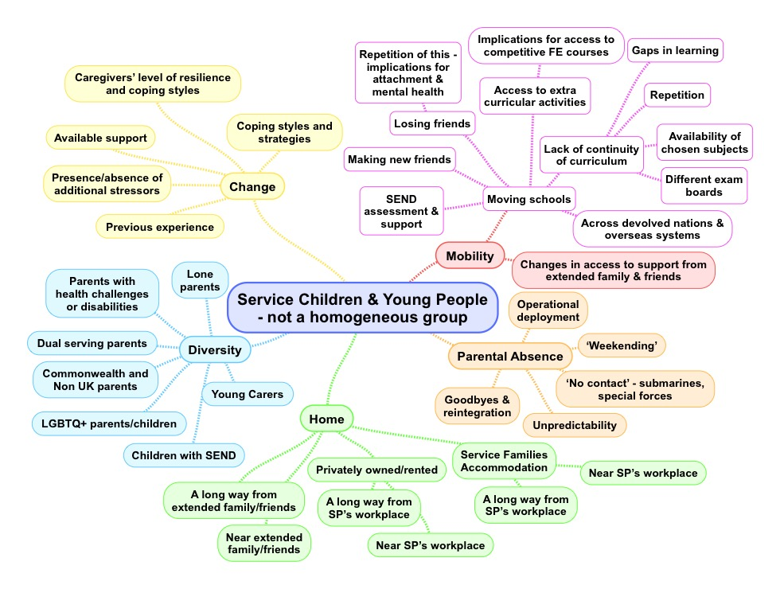
Notes:
One of the things we find from talking with Service children is that they are not one homogenous group of children and young people. While common themes do emerge, they are an incredibly diverse cohort. Some identify strongly as Service children, others do not. Their home lives and schooling may have been impacted to varying degrees and in different ways over their lifetime. They will have had differing family structures and vastly differing experiences of being able to access support. Their families may originate from outside the UK, they may have moved many times, or they may have lived in the same house for many years but been separated from one or both parents for long periods. The majority of Armed Forces children don’t expect or ask for any kind of special treatment – their situation is ‘normal’ to them, even though it may involve challenges and difficulties that are unique to Service life.

Slide 6
Contact details
Bridget Nicholson
Director of Evidence and Strategy
Naval Families Federation
Bridget.Nicholson@nff.org.uk
Anna Hutchinson
Education and Childcare Specialist
Army Families Federation
ec@aff.org.uk
Louise Briggs
Policy Advisor (Education and Childcare)
RAF Families Federation
louise.briggs@raf-ff.org.uk

