Slide 1
Collaboration between the SCiP Alliance and the SCISS network
@scipalliance
Katherine Lawrence
SCiP Alliance manager

Slide 2
What makes service children great potential HE students?
Notes:
Strengths
30 seconds to think
5 mins to discuss

Slide 3
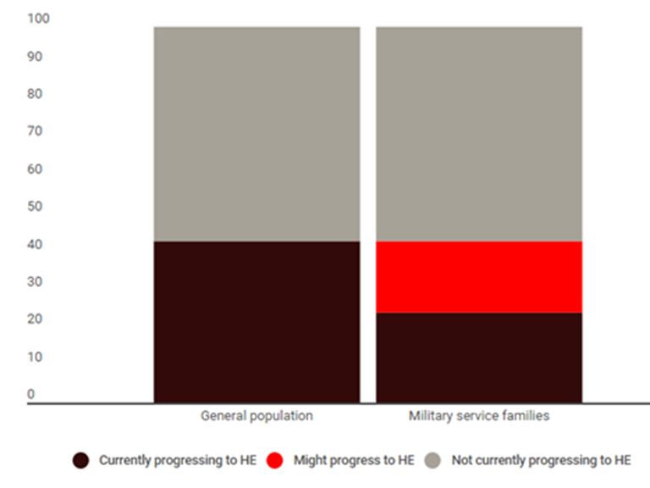
The challenge
Around 4 in 10 children from military families who have the ability to go to university do not do so*.
* McCullouch and Hall, 2016, Further and Higher Progression for Service Children, University of Winchester

Slide 4
The HE sector context
c. £725 million expenditure on access, success and progression*
New OFFA guidance includes:
‘Children from military families where they face specific issues that might affect their access to higher education.’
*OFFA 2015
Predicted to rise to £750.9 million in the academic year 2019-20
Notes:
2017-18 access agreements 5 unis (UoW, Bath Spa, Suffolk, Southampton, Harper Adams)
Universities and colleges have told us in their access agreements for 2015-16 and beyond that they plan to substantially increase their access agreement investment each year to reach a predicted £750.9 million in the academic year 2019-20
In the academic year 2014-15 (the most recent year for which we have data on actual investment), universities and colleges spent £725 million on access measures under their access agreements, not including funding contributed by the Government for the National Scholarship Programme. This represents 30 per cent of their income from fees above the basic level.
https://www.offa.org.uk/press/quick-facts/#overallspend

Slide 5
Champion the progression of the children
of military personnel, so that they can make informed and confident transitions through further and higher education into thriving adult lives and careers.

Slide 6
The SCiP Alliance provides
A UK-wide strategy
A research hub and a practice hub
An online resource
A voice for service children and those supporting their progression

Slide 7
Collaboration
SCISS is represented on the SCiP Alliance board and practice group
The SCiP Alliance is represented on the SCISS NEAC
Conference collaboration

Slide 8
Bespoke outreach
Aspirational days creating links between children and schools
Student ambassadors from service background
The University of Winchester and Bath Spa University working with Hampshire County Council / North Yorks County Council: teacher CPD
Children: ‘Listening to 'grown up' service children talking about their experiences’
Teachers: ‘New ideas to take back to school’

Slide 9
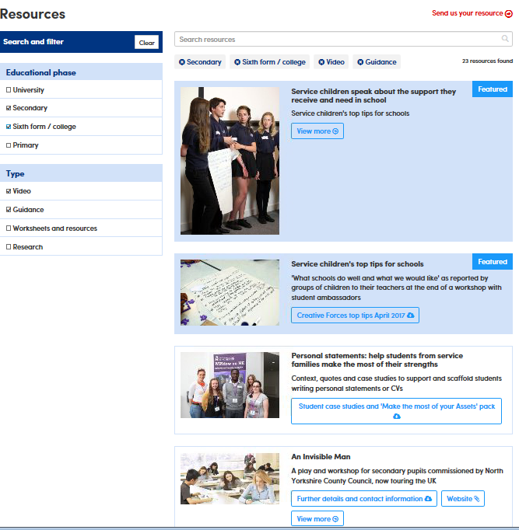
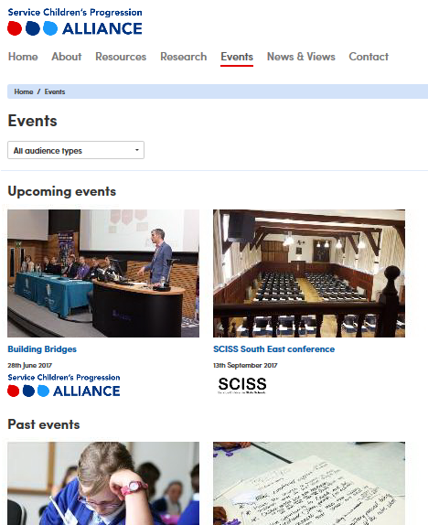
Get involved
info@scipalliance.org / katherine.lawrence@winchester.ac.uk

