Slide 1
Creative Forces Day Events, A shared experience: How we worked collaboratively to plan and deliver
Jessica Darnell, Strategic Projects Manager, LiNCHigher Uni Connect
Louisa Dobson, Programme Manager, FutureHY Uni Connect
Izzy Tooke, Communications Officer, FutureHY Uni Connect

Slide 2
A local hub for local solutions
Build relationships with local key partners - like universities, local authorities, military charities
Share effective practice, common challenges, new ideas, and achievements
Influence national (and UK-wide) policy as a network
Engage in new projects and research.
Capture learner voice of young people in the local area.
Opportunities to attend local CPD event and meetings - like today!

Slide 3


Yorkshire and North East Hub
Led by FutureHY Uni Connect partnership
Established in January 2018.
Membership of over 50 including HEIs, Colleges, LAs and Schools.
Deliver range of activities including Thriving Lives Toolkit CPD, Creative Forces Days and Festival of Friends Project.

Slide 4

Spotlight on: Festival of Friends 2021
£20k grant from Armed Forces Covenant Fund
School improvement project.
CPD sessions for teachers – Thriving Lives framework
Local networks across North Yorkshire run by teachers for teachers.
End of project celebration event held online.
National project – Guidance pack available from SCiP Alliance

Slide 5


Lincolnshire and East Midlands Hub
Led by LiNCHigher Uni Connect partnership
Established in October 2020
Membership of over 30 including HEIs, Colleges, LAs and Schools.
Deliver and create a range of activities including Thriving Lives Toolkit CPD, Creative Forces Days and Armed Forces .

Slide 6
This workshop will cover:
Logistical planning - hear how we planned and organised the events from inception to delivery.
Collaborative working - we will share best practice on working together to develop new activity.
Learner voice - we will share what we learned from the young people who participated in our events to help inform future practice.

Slide 7
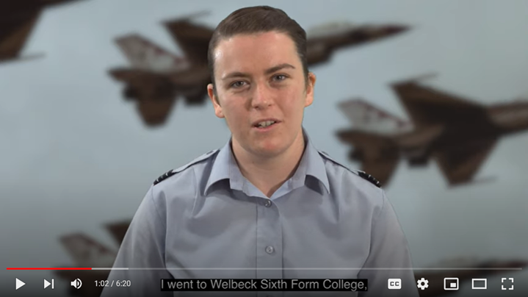
Creative Forces Day Introduction: Flight Lieutenant Pip Lloyd Williams

Slide 8
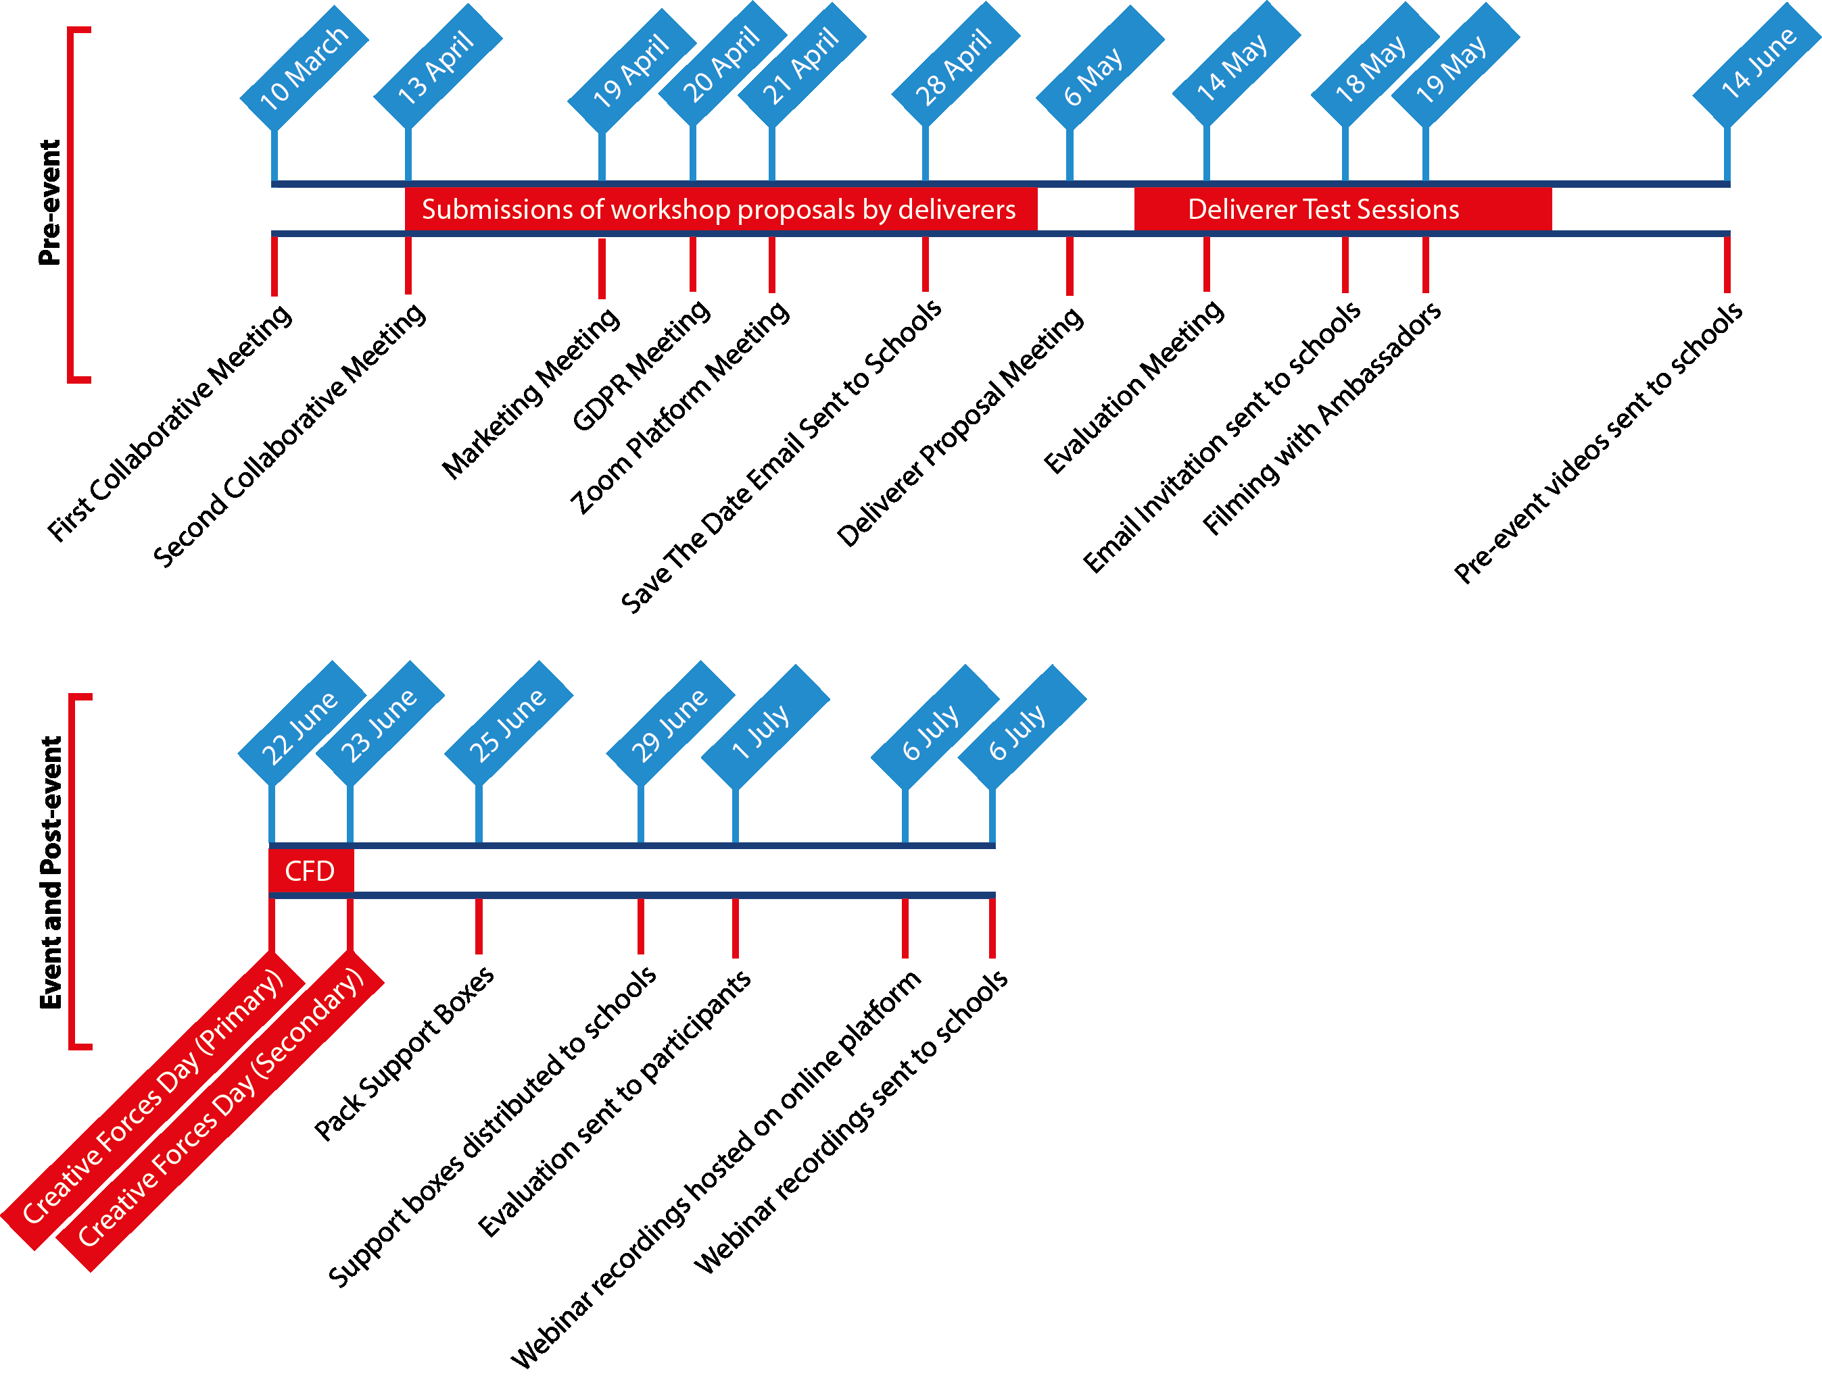

Slide 9


Slide 10
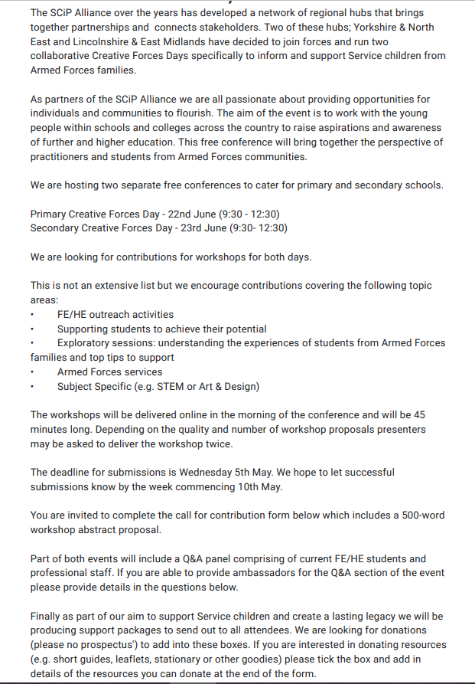
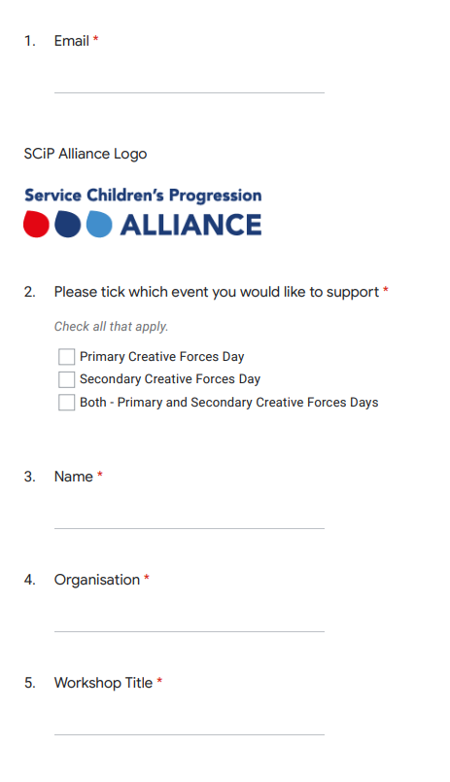
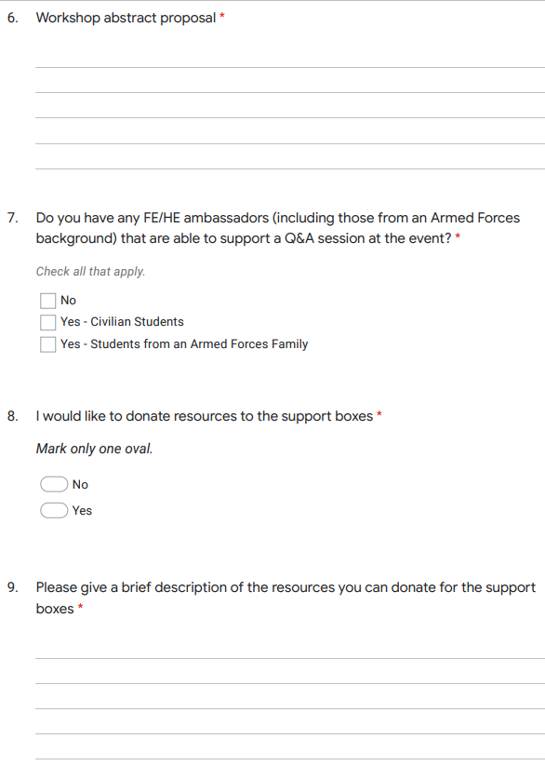

Slide 11
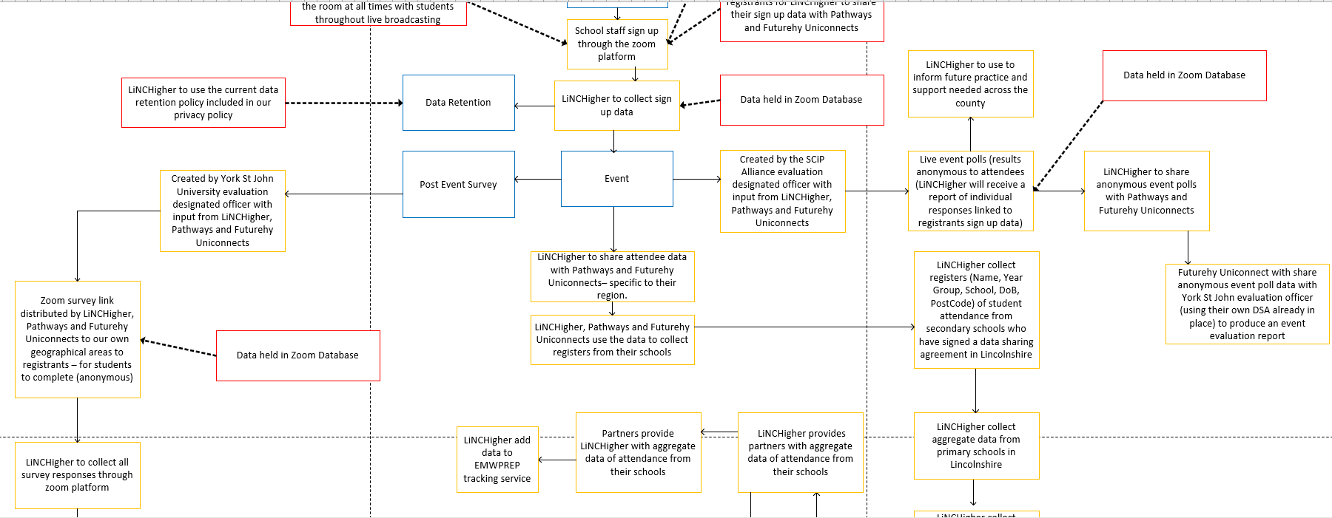

Slide 12
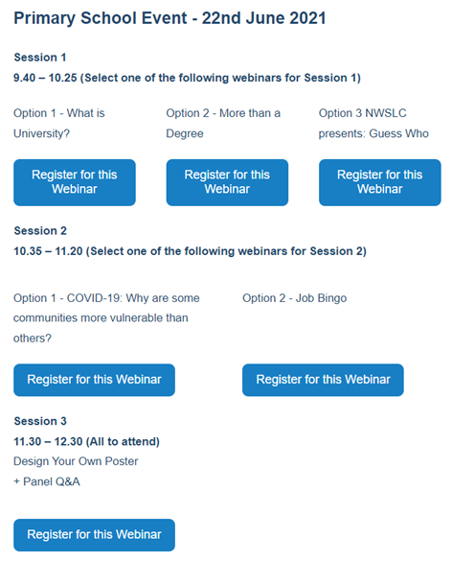
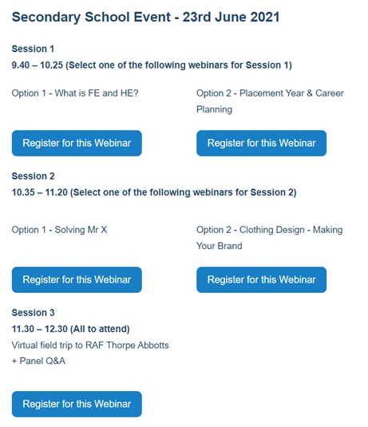

Slide 13
Session content
Activity | Date/time | Details
Pre-event
Pre-recorded video | Early June | Inspirational talk, introduction to the key themes of the event, request for questions for Q&A panel
Event
Introduction | 09.30-09.40 | Introduction to the event - objectives and structure
Workshop 1 | 09.40-10.25 | Key theme - FE & HE
Break 1 | 10.25-10.35
Workshop 2 | 10.35-11.20 | Key theme - Subject specific
Break 2 | 11.20-11.30
Workshop 3 | 11.30-12.00 | Key theme - Armed Forces
Q&A & close | 12.00-12.30 | Student ambassadors and key partners to be present in Q&A panel to close the event

Slide 14
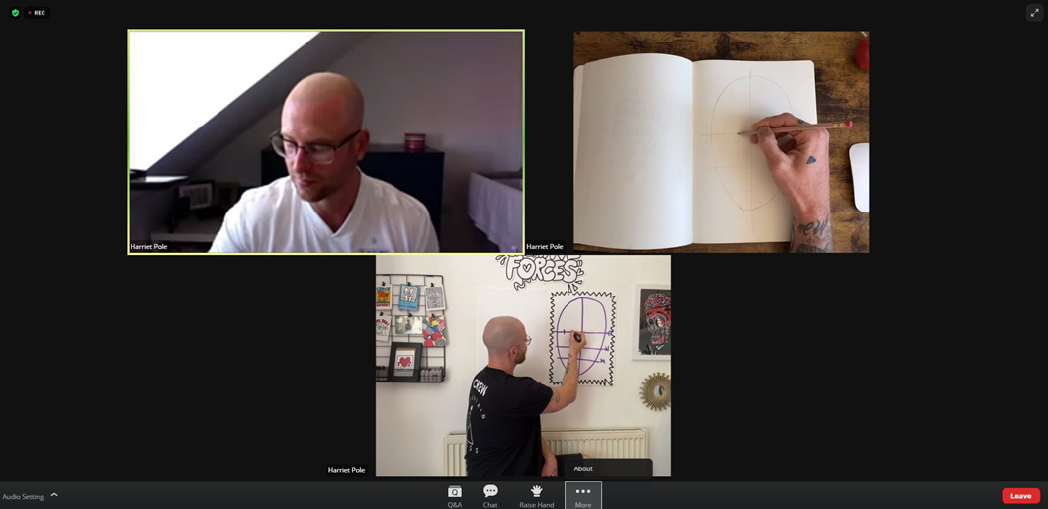
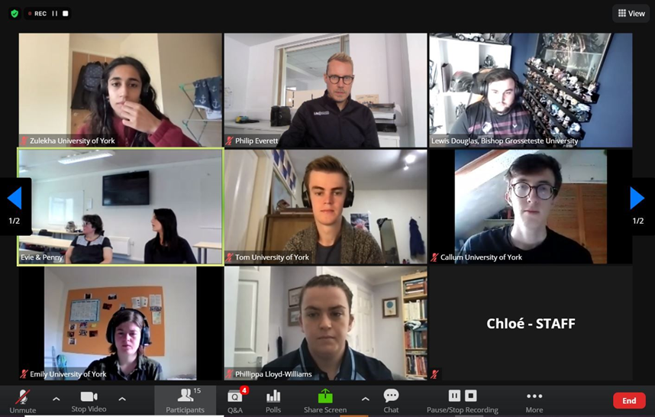

Slide 15
Feedback – Richmond School
30 Year 9 pupils attended
Selected three workshops to attend:
  What is FE and HE? - North Warwickshire And South Leicestershire College
  How to draw faces – Creative Kingdoms UK
  Virtual Field Trip to RAF Thorpe Abbotts in Norfolk - Bishop Grosseteste University

Slide 16
Quotes from participants
Liz Mannion, Head of Careers, said:
"Our Year 9 students did very well and demonstrated excellent skills throughout. They listened well to the Zoom meeting which was broadcast into the classroom and followed instructions well. They were very engaged in all the activities and particularly fascinated by the history of RAF Thorpe Abbotts."
The pupils said:
"It was fun and different."
"I felt like I had a bigger variety of things to do in my future"
"this session was relatable as I could understand my peers feelings"
"I gained confidence"
"it was fascinating to find out about WW2 bases"

Slide 17
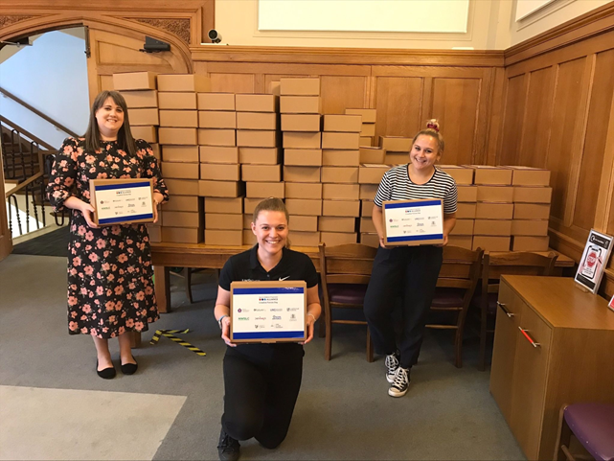

Follow up activity

Slide 18
Sharing best practice – what we learned!
Have lots of ways to communicate
Include civilian pupils
Engage with as many diverse HEIs and Colleges as you can
Consider offering a Hybrid model of delivery
Involve Service Children Student Ambassadors

Slide 19
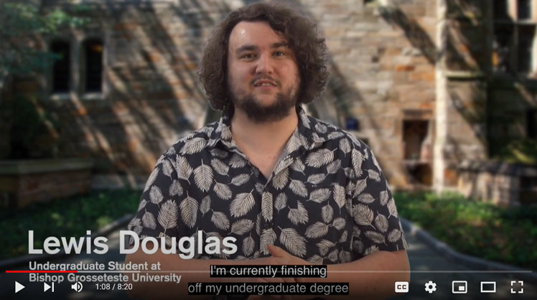
Creative Forces Day Introduction: Lewis Douglas

Slide 20
Discussion time!
We are going to break into three groups:
- Delegates who are have an interest in the topic and would like to discuss further resources and signposting to further information.
- Delegates who would like to plan a similar activity and develop an action plan
- Delegates who are already in the planning stages of their event and would like to ask further questions and obtain feedback.
Please use the Action Plan templates provided to map out your next steps.

Slide 21
Thank you for joining us!

